Slide 1

Spack: Package Management for HPC
ATPESC 2024 Software Track
Todd Gamblin
Spack Project Lead Distinguished Member of Technical Staff Lawrence Livermore National Laboratory

Slide 2
Background

Slide 3
We build codes from hundreds of small, complex pieces
Just when we’re starting to solve the problem of how to create software using reusable parts, it founders on the nuts-and-bolts problems outside the software itself.
P. DuBois & T. Epperly. Why Johnny Can’t Build. Scientific Programming. Sep/Oct 2003.
Component-based software development dates back to the 60’s
M.D. McIlroy, Mass Produced Software Components. NATO SE Conf., 1968
Pros are well known:
Teams can and must reuse each others’ work
Teams write less code, meet deliverables faster
Cons:
Teams must ensure that components work together
Integration burden increases with each additional library
Integration must be repeated with each update to components
Components must be vetted!
Managing changes over time is becoming intractable
Build-time incompatibility; fail fast
Appears to work; subtle errors later

Slide 4

Modern scientific codes rely on icebergs of dependency libraries
71 packages
188 dependencies
MFEM: Higher-order finite elements
31 packages,
69 dependencies
LBANN: Neural Nets for HPC
r-condop: R Genome Data Analysis Tools
179 packages,
527 dependencies

Slide 5
Even proprietary software builds on top of open source
LLNL ARES
30
12
71
Open source is critical for nearly every application
We cannot replace all these OSS components with our own
How do we put them all together effectively?
Do you have to integrate this stuff by hand?

Slide 6
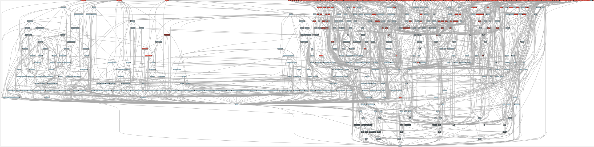
ECP’s E4S stack is even larger than these codes
Red boxes are the packages in it (about 100)
Blue boxes are what else you need to build it (about 600)
It’s infeasible to build and integrate all of this manually

Slide 7
Some history: How to install software on a supercomputer, circa 2013
Download all 16 tarballs you need
Start building!
configure
cmake
make install
Fight with compiler...
Tweak configure args...
make
make
configure
configure
make install
make install
make
make
make
Run code
Segfault!?
Start over…

Slide 8
What does a package managers do to help?
Package Manager
Package installation
May drive package-level build systems
High Level Build System
Cmake, Autotools
Handle library abstractions
Low Level Build System
Make, Ninja
Handles dependencies among commands in a single build
Generate Makefiles, etc.
Dependency relationships, conflicts
Does not a replace Cmake/Autotools
Manages dependencies
Drives package-level build systems
Ensures consistency and compatibility among builds of packages in the ecosystem
Stores community knowledge
Cache of package build recipes
Determining magic configure lines takes time

Slide 9
Many package managers (conda, pip, apt, etc.) make simplifying assumptions about the software ecosystem
1:1 relationship between source code and binary (per platform)
Good for reproducibility (e.g., Debian)
Bad for performance optimization
Binaries should be as portable as possible
What most distributions do
Again, bad for performance
Toolchain is the same across the ecosystem
One compiler, one set of runtime libraries
Or, no compiler (for interpreted languages) and just one language
Outside these boundaries, users are typically on their own

Slide 10
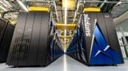
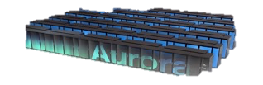
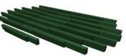


High Performance Computing (HPC) violates many of these assumptions
Some Supercomputers
Code is typically distributed as source
With exception of vendor libraries, compilers
Often build many variants of the same package
Developers’ builds may be very different
Many first-time builds when machines are new
Code is optimized for the processor and GPU
Must make effective use of the hardware
Can make 10-100x perf difference
Rely heavily on system packages
Need to use optimized libraries that come with machines
Need to use host GPU libraries and network
Multi-language
C, C++, Fortran, Python, others all in the same ecosystem
Summit
Fugaku
Oak Ridge National Lab
Power9 / NVIDIA
RIKEN
Fujitsu/ARM a64fx
NERSC-9
Aurora
Perlmutter
Lawrence Berkeley National Lab
AMD Zen / NVIDIA
Argonne National Lab
Intel Xeon / Xe
Lawrence Livermore National Lab AMD Zen / Radeon
Oak Ridge National Lab
AMD Zen / Radeon

Slide 11
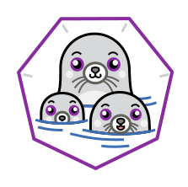




What about containers?
Containers provide a great way to reproduce and distribute an already-built software stack
Someone needs to build the container!
This isn’t trivial
Containerized applications still have hundreds of dependencies
Using the OS package manager inside a container is insufficient
Most binaries are built unoptimized
Generic binaries, not optimized for specific architectures
HPC containers are often optimized per-system
Not clear that we can ever build one container for all facilities
We need something more flexible to build versions of containers

Slide 12
Overview & Community

Slide 13
Spack enables Software distribution for HPC
Spack automates the build and installation of scientific software
Packages are parameterized, so that users can easily tweak and tune configuration
Ease of use of mainstream tools, with flexibility needed for HPC
In addition to CLI, Spack also:
Generates (but does not require) modules
Allows conda/virtualenv-like environments
Provides many devops features (CI, container generation, more)
Supports binary “buildcaches” so that you don’t have to build everything from source
No installation required: clone and go
$ git clone https://github.com/spack/spack
$ spack install hdf5
Simple syntax enables complex installs
$ spack install hdf5@1.10.5
$ spack install hdf5@1.10.5 %clang@6.0
$ spack install hdf5@1.10.5 +threadssafe
$ spack install hdf5@1.10.5 cppflags="-O3 –g3"
$ spack install hdf5@1.10.5 target=haswell
$ spack install hdf5@1.10.5 +mpi ^mpich@3.2
github.com/spack/spack

Slide 14
Who can use Spack?
People who want to use or distribute software for HPC!
End Users of HPC Software
Install and run HPC applications and tools
HPC Application Teams
Manage third-party dependency libraries
Package Developers
People who want to package their own software for distribution
User support teams at HPC Centers
People who deploy software for users at large HPC sites

Slide 15
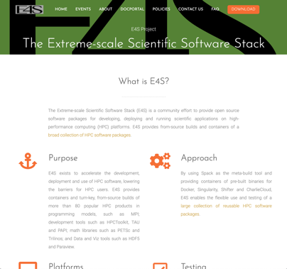

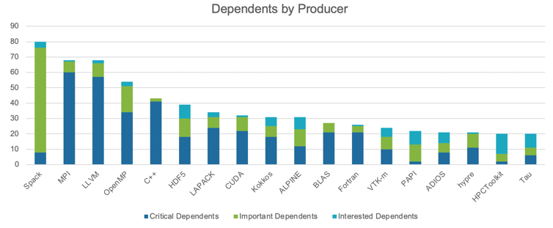
Spack was critical for ECP’s mission to create a robust, capable exascale software ecosystem.
https://e4s.io
Used for building software on the three U.S. exascale systems
ECP built the Extreme Scale Scientific Software Stack (E4S) with Spack – more at https://e4s.io
Project continues on ASC and ASCR funding
Spack was the most depended-upon project in ECP

Slide 16
Fall 2020
2016
2024
2023
Spring 2018
Spring 2021
Fall 2018
Fall 2021

Slide 17
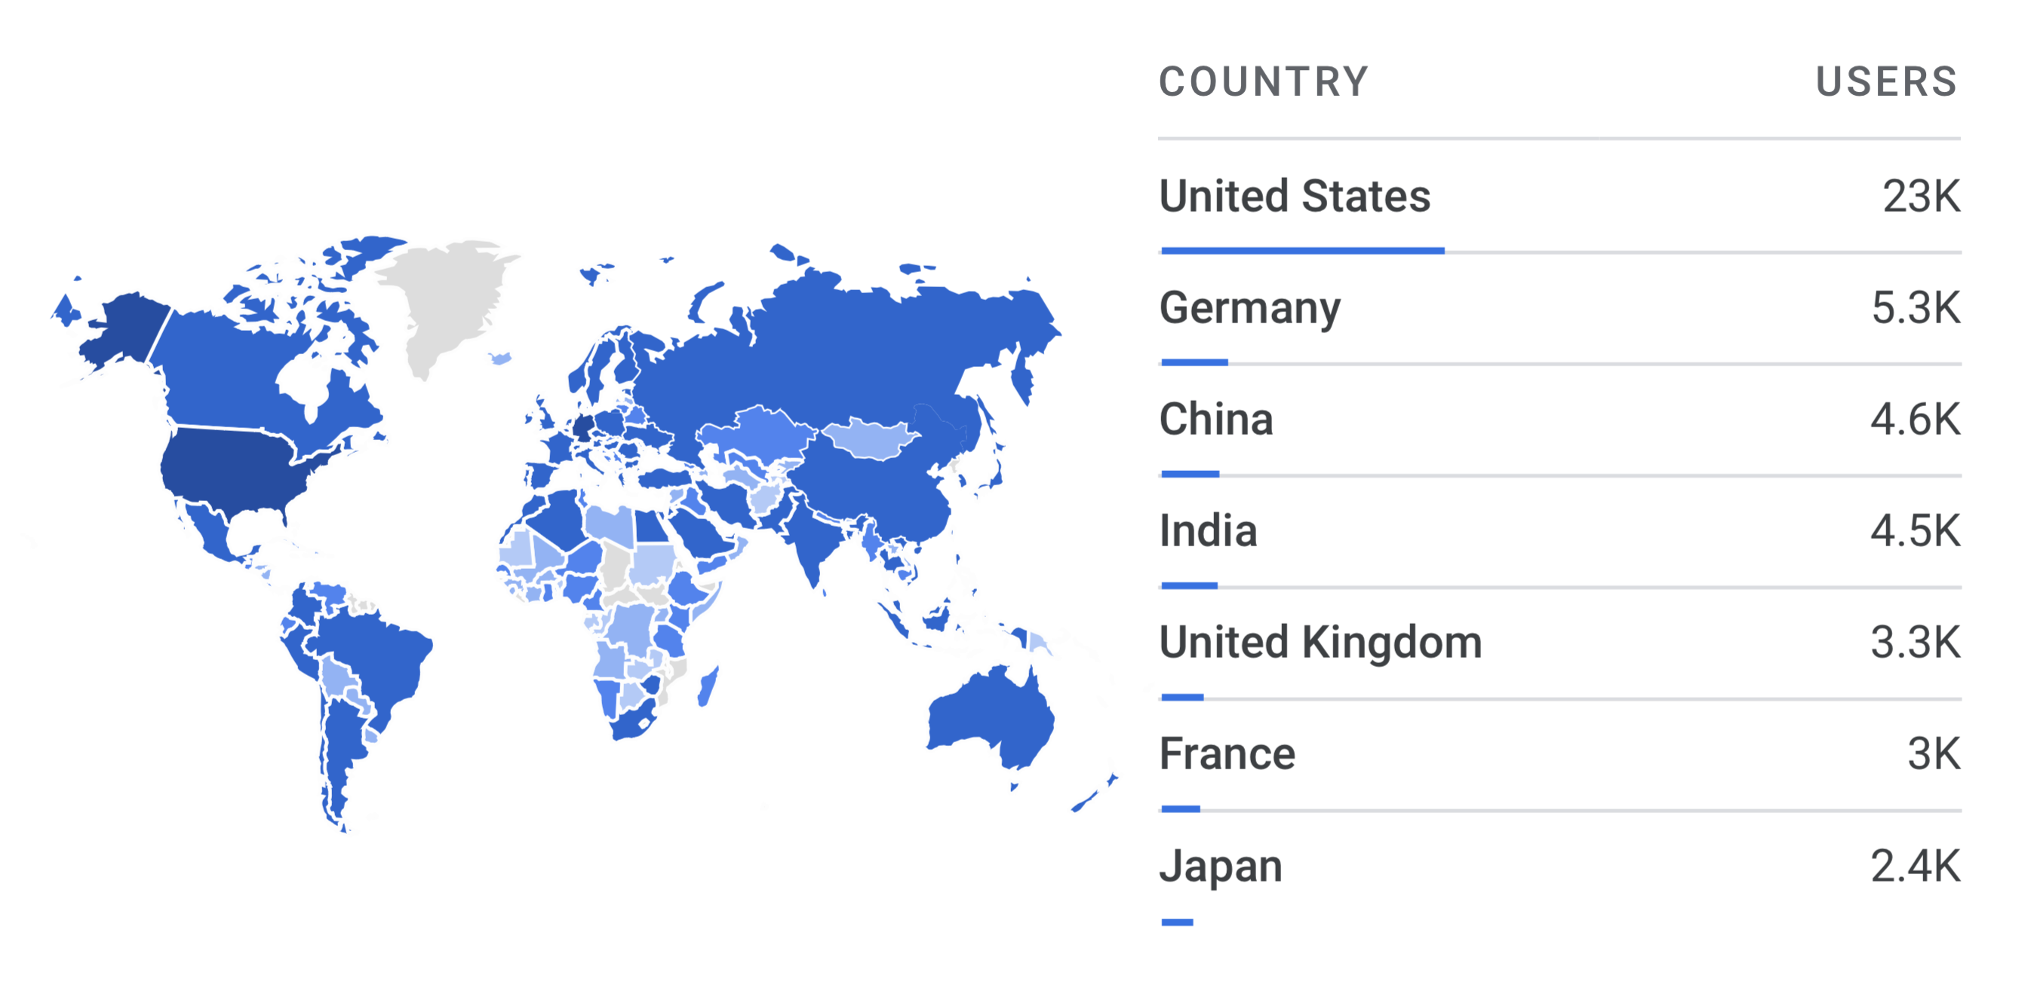
Spack sustains the HPC software ecosystem with the help of many contributors
Over 8,000 software packages
Over 1,300 contributors
2023 aggregate documentation user counts from GA4
(note: yearly user counts are almost certainly too large)
Contributors continue to grow worldwide!

Slide 18
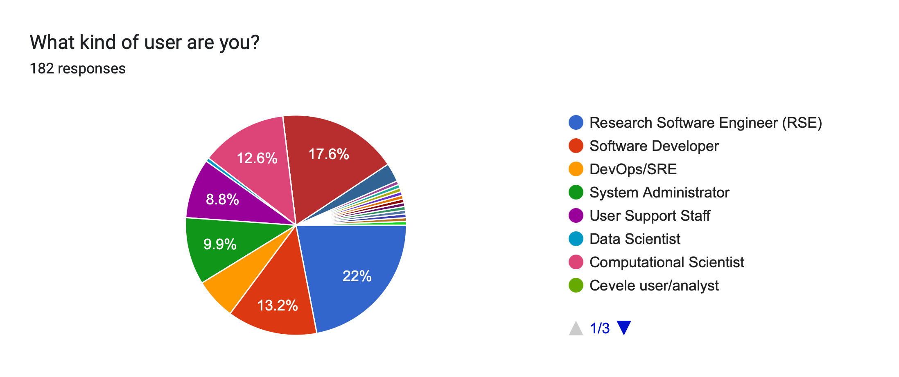
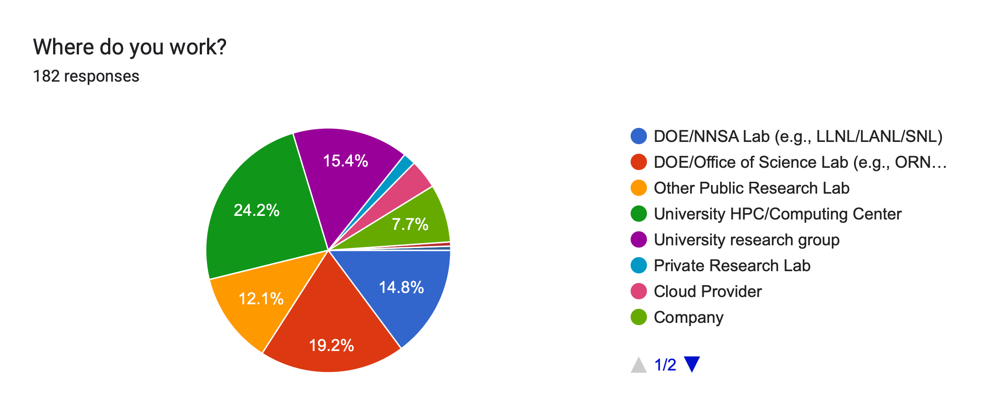
Spack users have diverse roles across many types of institutions
What type of user are you?
Where do you work?

Slide 19
What does the Spack project look like now?
E4S
AWS
LLNL stack
xSDK
Vis SDK
App
. . .
Spack Community 💁‍♂️ 💁🏾 💁 💁🏻‍♀️ 💁🏻 💁🏾‍♂️ 💁🏻‍♂️ 💁‍♀️ 💁🏼‍♂️ 💁🏾‍♀️ 💁🏼 💁🏽‍♀️ 💁🏽‍♂️ 💁🏽 💁🏼‍♀️ 💁🏼‍♂️
CI Infrastructure
Package Recipes
Core tool (CLI + Solver)

Slide 20






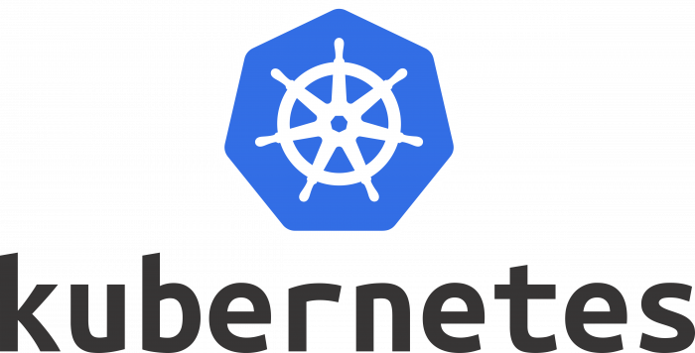


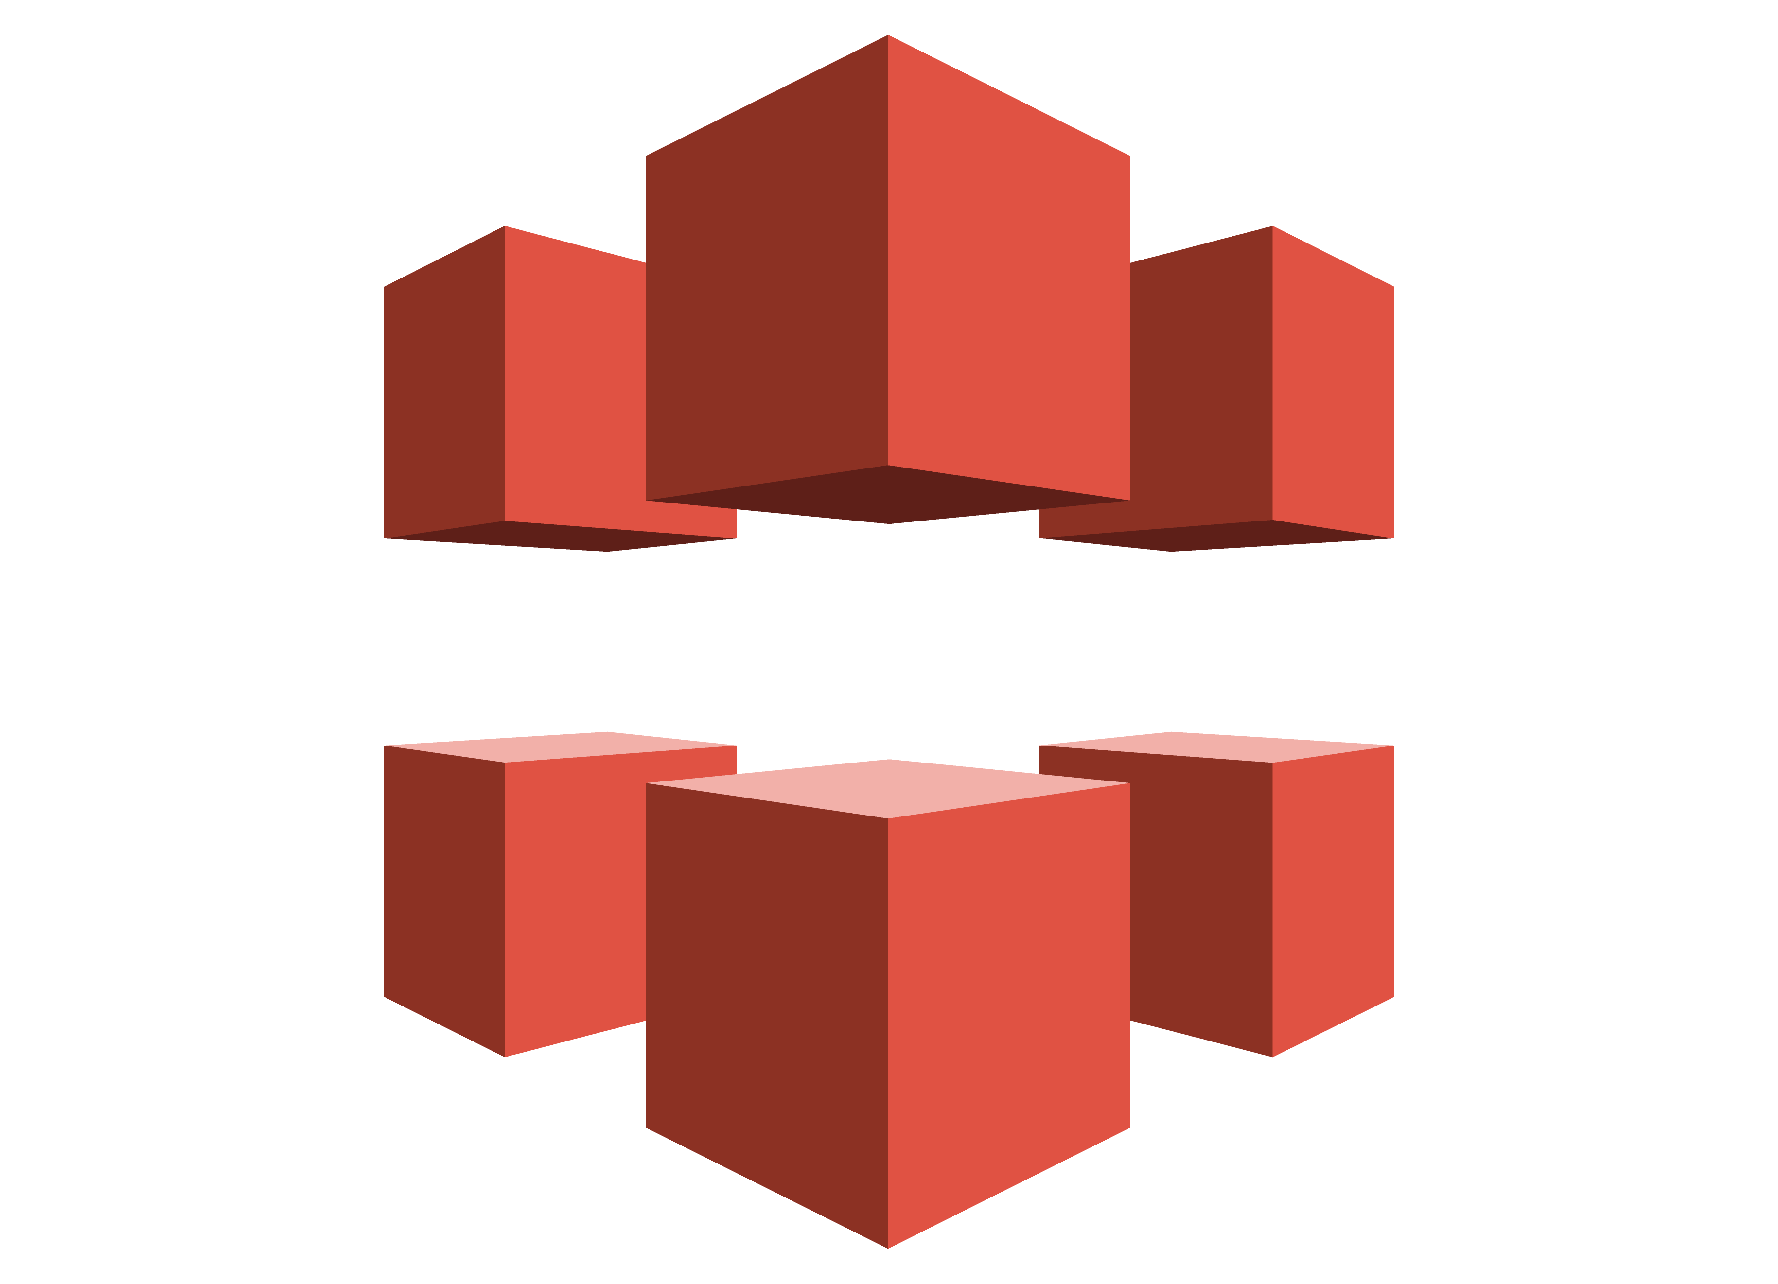
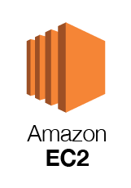





Spack CI Architecture
NVIDIA
etc.
MI200
etc.
a64fx
etc.
Spack on GitHub
Monitoring
HA GitLab
Power9
Runner Pools
Runner Pools
Runner Pools
Runner Pools
Bare metal runners on “Frank” cluster
spackbot
(EKS)
GCP Runners
S3
CloudFront

Slide 21
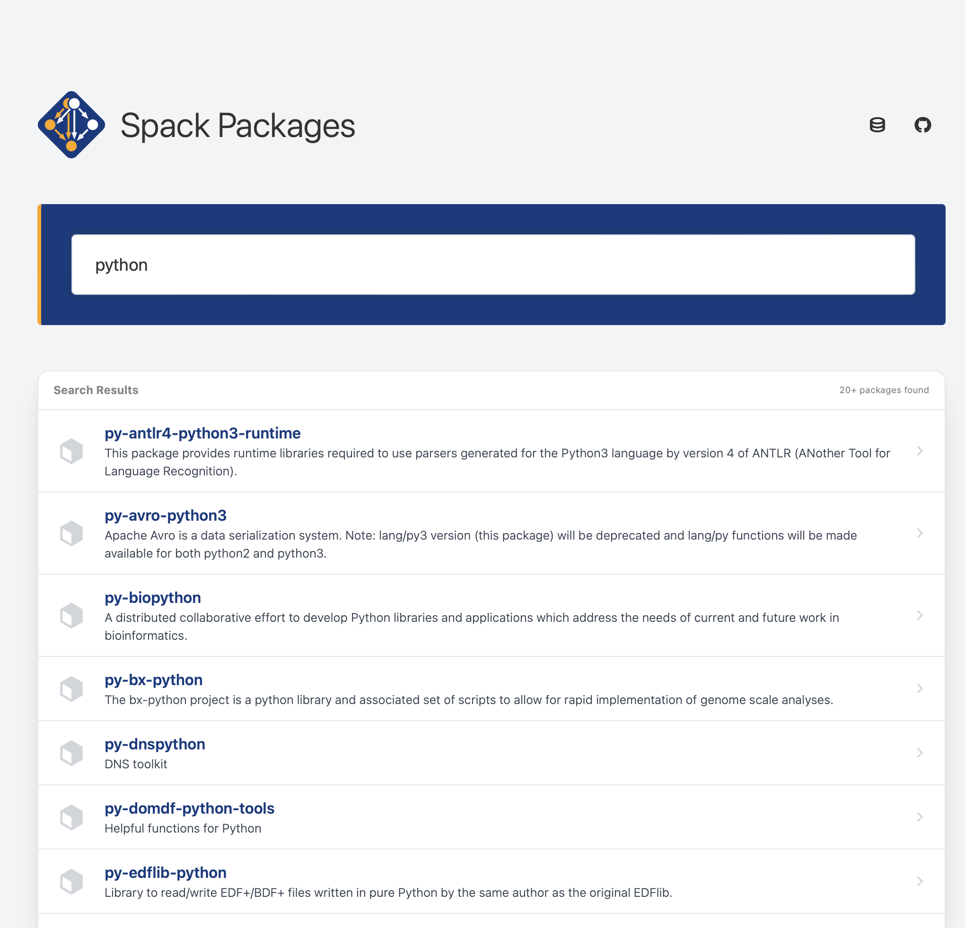
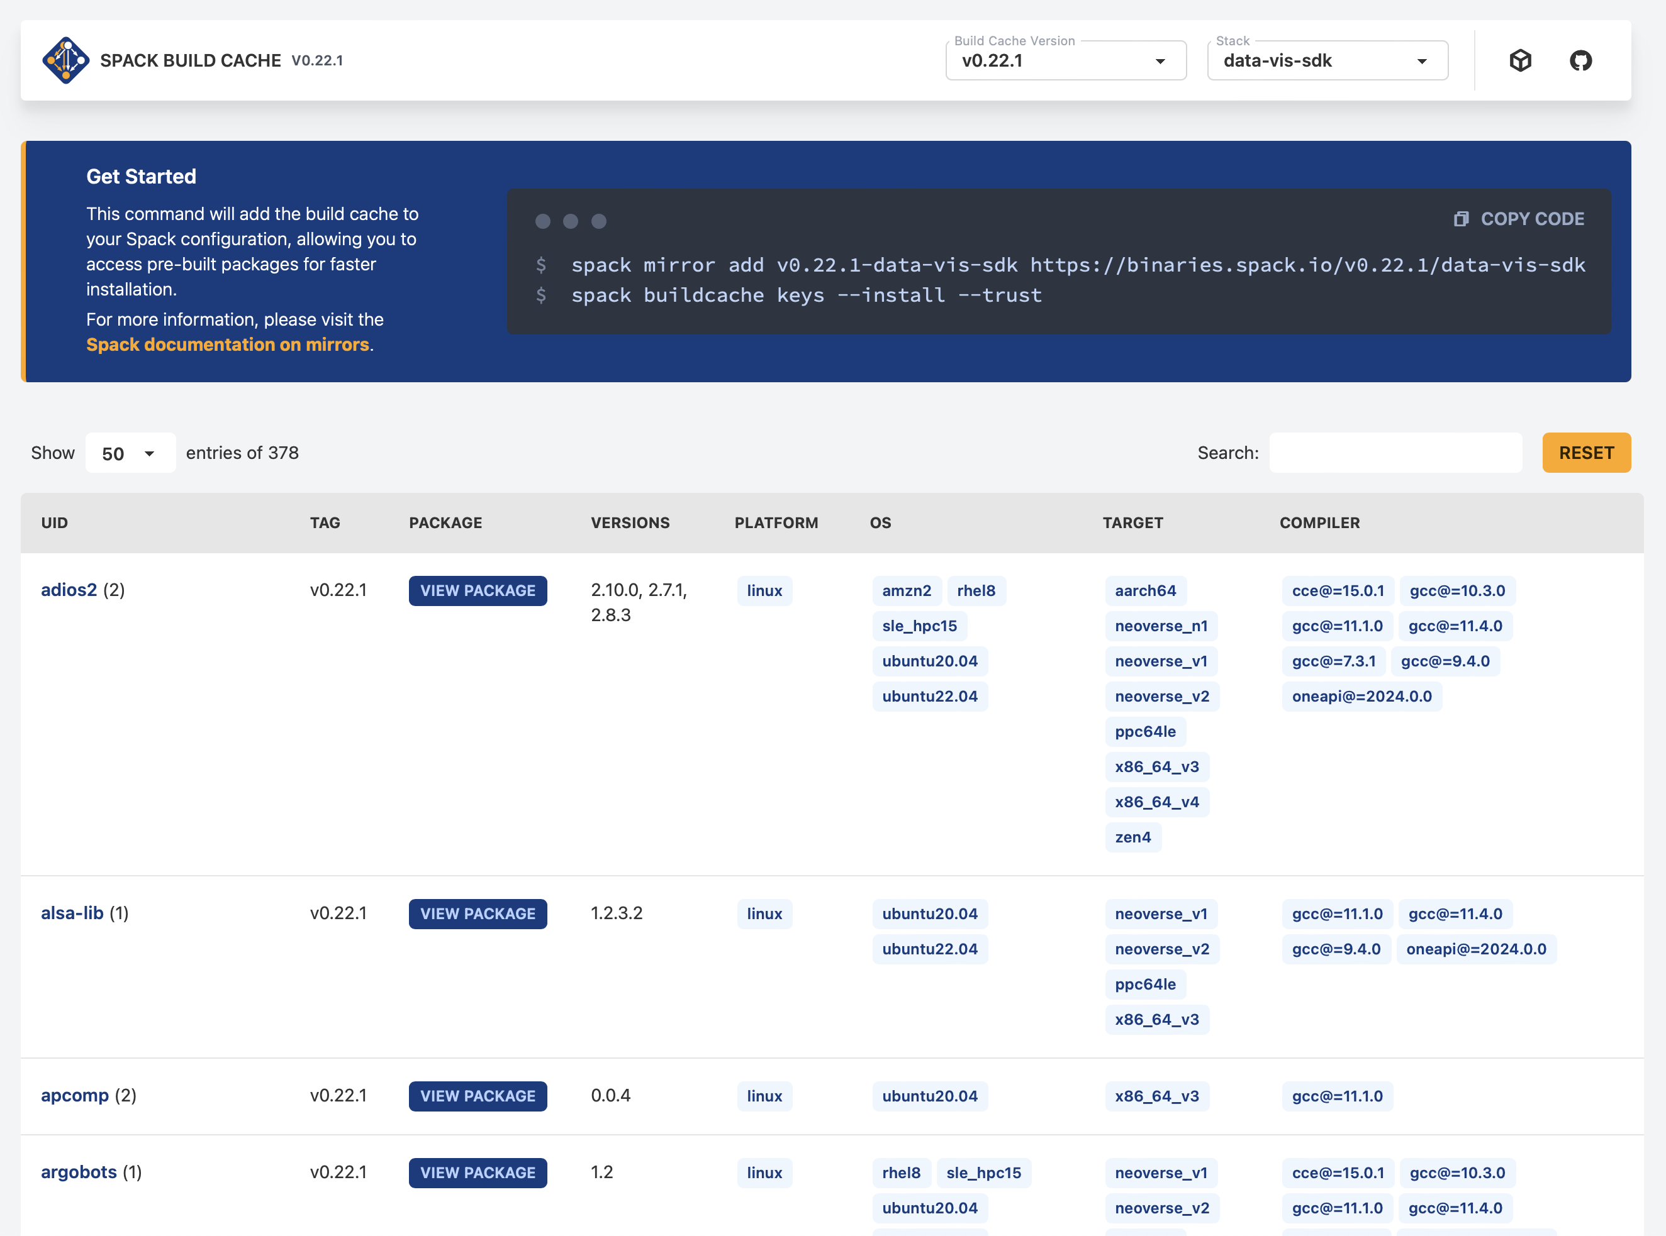
CI enables us to maintain public build caches
We test a subset of package builds:
In CI for every pull request
On release branches
On the develop branch
We provide build caches for:
Every release
Latest develop branch
Weekly develop snapshots
Different architectures and software stacks
Find available packages at packages.spack.io
See available builds at cache.spack.io

Slide 22
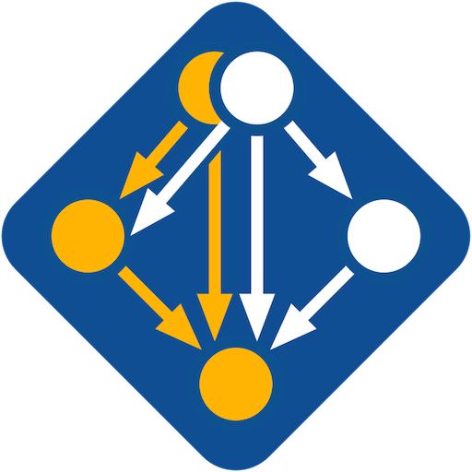

Spack recently became a Linux Foundation Project!
What does that mean?
Spack has a legal entity: a 501(c)(6) non-profit company
This is a neutral legal entity
Can be in legal agreements (e.g. for distributing binaries)
Can get discounts on, e.g., Slack
Spack will have a Technical Steering Committee (TSC)
Plan is to make the main developer meetings more public
Also have official steering committee meetings
Working on initial GOVERNANCE.md, initial TSC members
Trademark (Spack name, logo) assigned to Linux Foundation
Spack project resources owned by Linux Foundation:
spack.io website
GitHub Organization
Why are we doing this?

Slide 23





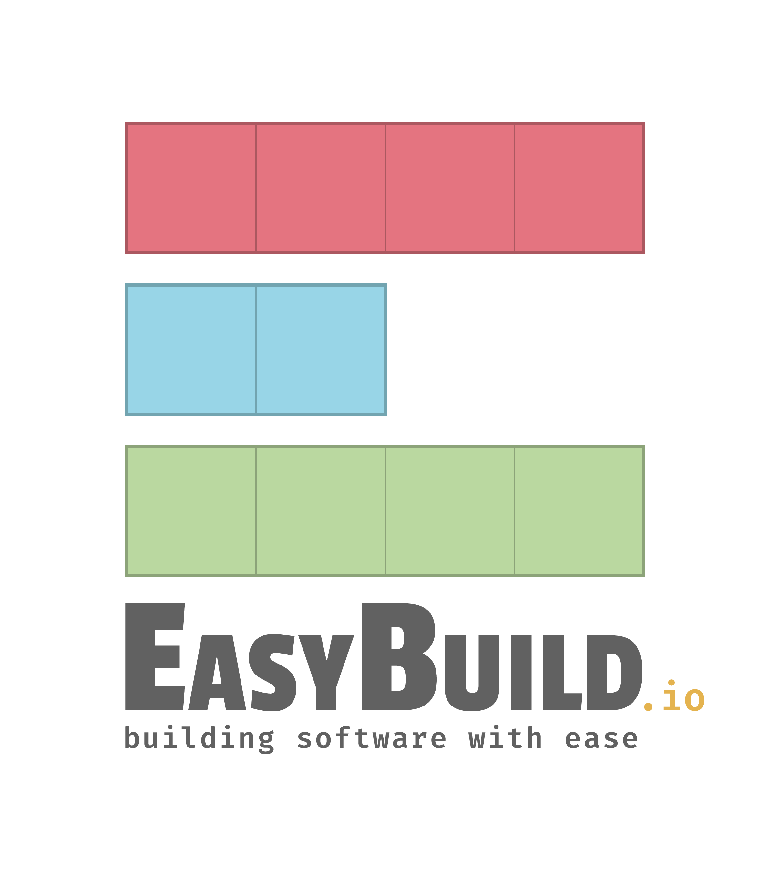


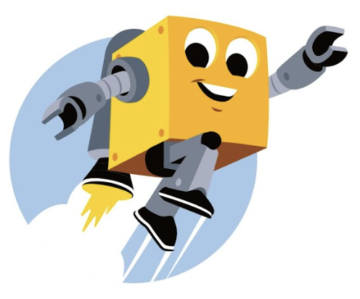
Spack is not the only HPC/AI/data science package manager out there
“Functional” Package Managers
Nix https://nixos.org
Guix https://hpc.guix.info
Build-from-source Package Managers
Homebrew, LinuxBrew https://brew.sh
MacPorts https://www.macports.org
Gentoo https://gentoo.org
Other tools in the HPC Space:
Easybuild
An installation tool for HPC https://easybuild.io
Focused on HPC system administrators – different package model from Spack
Relies on a fixed software stack – harder to tweak recipes for experimentation
Conda / Mamba / Pixi https://conda.io
Very popular binary package ecosystem for data science https://mamba.readthedocs.io
Not targeted at HPC; generally has unoptimized binaries https://prefix.dev

Slide 24
Spack Usage

Slide 25
Spack provides a spec syntax to describe customized installations
$ spack install mpileaks unconstrained
$ spack install mpileaks@3.3 @ custom version
$ spack install mpileaks@3.3 %gcc@4.7.3 % custom compiler
$ spack install mpileaks@3.3 %gcc@4.7.3 +threads +/- build option
$ spack install mpileaks@3.3 cppflags="-O3 –g3" set compiler flags
$ spack install mpileaks@3.3 target=zen2 set target microarchitecture
$ spack install mpileaks@3.3 ^mpich@3.2 %gcc@4.9.3 ^ dependency information
Each expression is a spec for a particular configuration
Each clause adds a constraint to the spec
Constraints are optional – specify only what you need.
Customize install on the command line!
Spec syntax is recursive
Full control over the combinatorial build space

Slide 26
Spack packages are templates They use a simple Python DSL to define how to build
Not shown: patches, resources, conflicts, other directives.
from spack import *
class Kripke(CMakePackage):
"""Kripke is a simple, scalable, 3D Sn deterministic particle
transport proxy/mini app.
"""
homepage = "https://computation.llnl.gov/projects/co-design/kripke"
url = "https://computation.llnl.gov/projects/co-design/download/kripke-openmp-1.1.tar.gz"
version(‘1.2.3’, sha256='3f7f2eef0d1ba5825780d626741eb0b3f026a096048d7ec4794d2a7dfbe2b8a6’)
version(‘1.2.2’, sha256='eaf9ddf562416974157b34d00c3a1c880fc5296fce2aa2efa039a86e0976f3a3’)
version('1.1’, sha256='232d74072fc7b848fa2adc8a1bc839ae8fb5f96d50224186601f55554a25f64a’)
variant('mpi', default=True, description='Build with MPI.’)
variant('openmp', default=True, description='Build with OpenMP enabled.’)
depends_on('mpi', when='+mpi’)
depends_on('cmake@3.0:', type='build’)
def cmake_args(self):
return [
'-DENABLE_OPENMP=%s’ % ('+openmp’ in self.spec),
'-DENABLE_MPI=%s' % ('+mpi’ in self.spec),
]
def install(self, spec, prefix):
# Kripke does not provide install target, so we have to copy
# things into place.
mkdirp(prefix.bin)
install('../spack-build/kripke', prefix.bin)
Base package
(CMake support)
Metadata at the class level
Versions
Variants (build options)
Dependencies (same spec syntax)
Install logic in instance methods
Don’t typically need install() for CMakePackage, but we can work around codes that don’t have it.

Slide 27
Spack Specs can constrain versions of dependencies
$ spack install mpileaks %intel@12.1 ^libelf@0.8.12
Spack ensures one configuration of each library per DAG
Ensures ABI consistency.
User does not need to know DAG structure; only the dependency names.
Spack can ensure that builds use the same compiler, or you can mix
Working on ensuring ABI compatibility when compilers are mixed.

Slide 28
Spack handles ABI-incompatible, versioned interfaces like MPI
mpi is a virtual dependency
Install the same package built with two different MPI implementations:
Let Spack choose MPI implementation, as long as it provides MPI 2 interface:
$ spack install mpileaks ^mvapich@1.9
$ spack install mpileaks ^openmpi@1.4:
$ spack install mpileaks ^mpi@2

Slide 29
Concretization fills in missing configuration details when the user is not explicit.
mpileaks ^callpath@1.0+debug ^libelf@0.8.11
User input: abstract spec with some constraints
spec.yaml
spec:
- mpileaks:
arch: linux-x86_64
compiler:
name: gcc
version: 4.9.2
dependencies:
adept-utils: kszrtkpbzac3ss2ixcjkcorlaybnptp4
callpath: bah5f4h4d2n47mgycej2mtrnrivvxy77
mpich: aa4ar6ifj23yijqmdabeakpejcli72t3
hash: 33hjjhxi7p6gyzn5ptgyes7sghyprujh
variants: {}
version: '1.0'
- adept-utils:
arch: linux-x86_64
compiler:
name: gcc
version: 4.9.2
dependencies:
boost: teesjv7ehpe5ksspjim5dk43a7qnowlq
mpich: aa4ar6ifj23yijqmdabeakpejcli72t3
hash: kszrtkpbzac3ss2ixcjkcorlaybnptp4
variants: {}
version: 1.0.1
- boost:
arch: linux-x86_64
compiler:
name: gcc
version: 4.9.2
dependencies: {}
hash: teesjv7ehpe5ksspjim5dk43a7qnowlq
variants: {}
version: 1.59.0
...
Normalize
Concretize
Store
Abstract, normalized spec
with some dependencies
Concrete spec is fully constrained
and can be passed to install
Detailed provenance stored
with installed package

Slide 30
Spack handles combinatorial software complexity
Dependency DAG
Each unique dependency graph is a unique configuration.
Each configuration in a unique directory.
Multiple configurations of the same package can coexist.
Hash of entire directed acyclic graph (DAG) is appended to each prefix.
Installed packages automatically find dependencies
Spack embeds RPATHs in binaries.
No need to use modules or set LD_LIBRARY_PATH
Things work the way you built them
Installation Layout
Hash
opt
└── spack
├── linux-rhel7-skylake
│ └── gcc-8.3.0
│ ├── mpileaks-1.0-hc4sm4vuzpm4znmvrfzri4ow2mkphe2e
│ ├── callpath-1.0.4-daqqpssxb6qbfrztsezkmhus3xoflbsy
│ ├── openmpi-4.1.4-u64v26igxvxyn23hysmklfums6tgjv5r
│ ├── dyninst-12.1.0-u64v26igxvxyn23hysmklfums6tgjv5r
│ ├── libdwarf-20180129-u5eawkvaoc7vonabe6nndkcfwuv233cj
│ └── libelf-0.8.13-x46q4wm46ay4pltriijbgizxjrhbaka6
opt
└── spack
├── linux-rhel7-skylake
│ └── gcc-8.3.0
│ ├── mpileaks-1.0-hc4sm4vuzpm4znmvrfzri4ow2mkphe2e
│ ├── callpath-1.0.4-daqqpssxb6qbfrztsezkmhus3xoflbsy
│ ├── openmpi-4.1.4-u64v26igxvxyn23hysmklfums6tgjv5r
│ ├── dyninst-12.1.0-u64v26igxvxyn23hysmklfums6tgjv5r
│ ├── libdwarf-20180129-u5eawkvaoc7vonabe6nndkcfwuv233cj
│ └── libelf-0.8.13-x46q4wm46ay4pltriijbgizxjrhbaka6

Slide 31
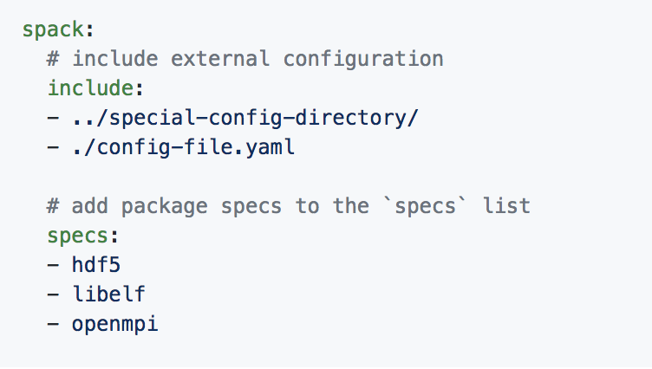
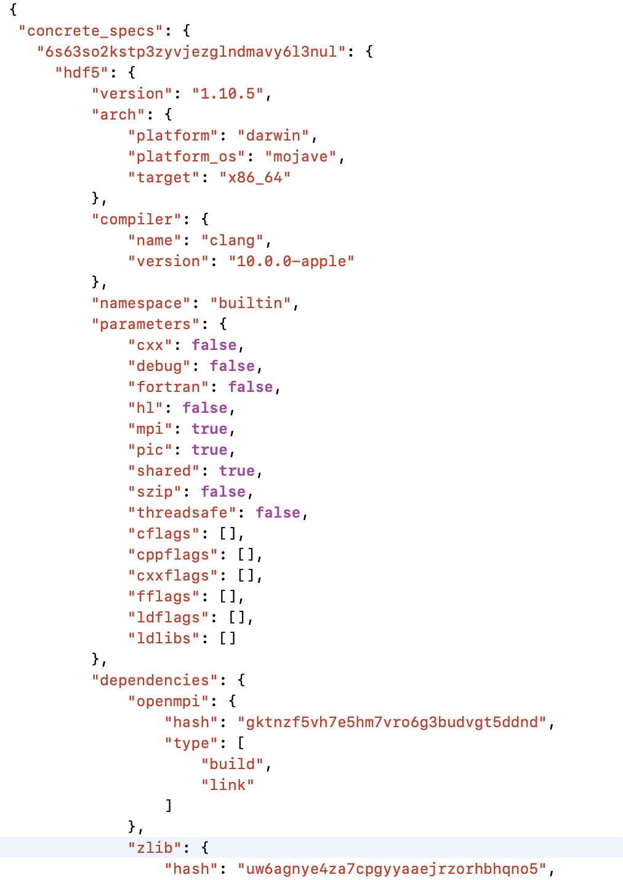
Spack environments enable users to build customized stacks from an abstract description
Simple spack.yaml file
Dependency packages
install
build project
spack.yaml file with names of required dependencies
Lockfile describes exact versions installed
spack.yaml describes project requirements
spack.lock describes exactly what versions/configurations were installed, allows them to be reproduced.
Can also be used to maintain configuration together with Spack packages.
E.g., versioning your own local software stack with consistent compilers/MPI implementations
Allows developers and site support engineers to easily version Spack configurations in a repository
Concrete spack.lock file (generated)

Slide 32
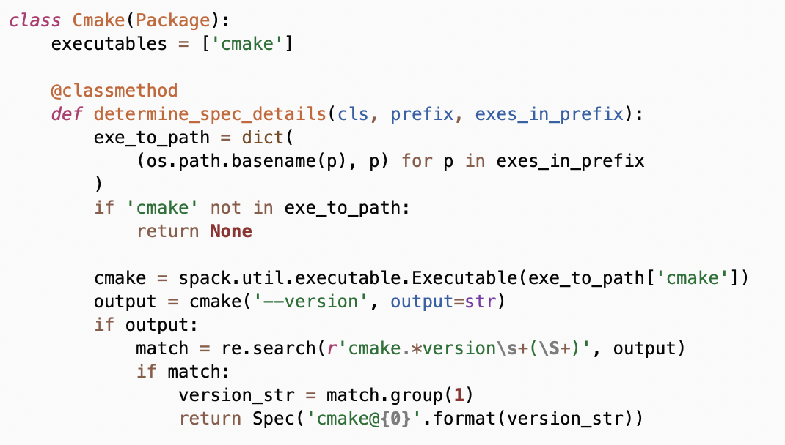
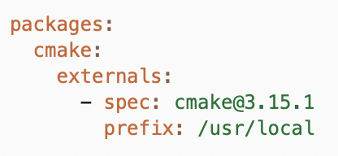
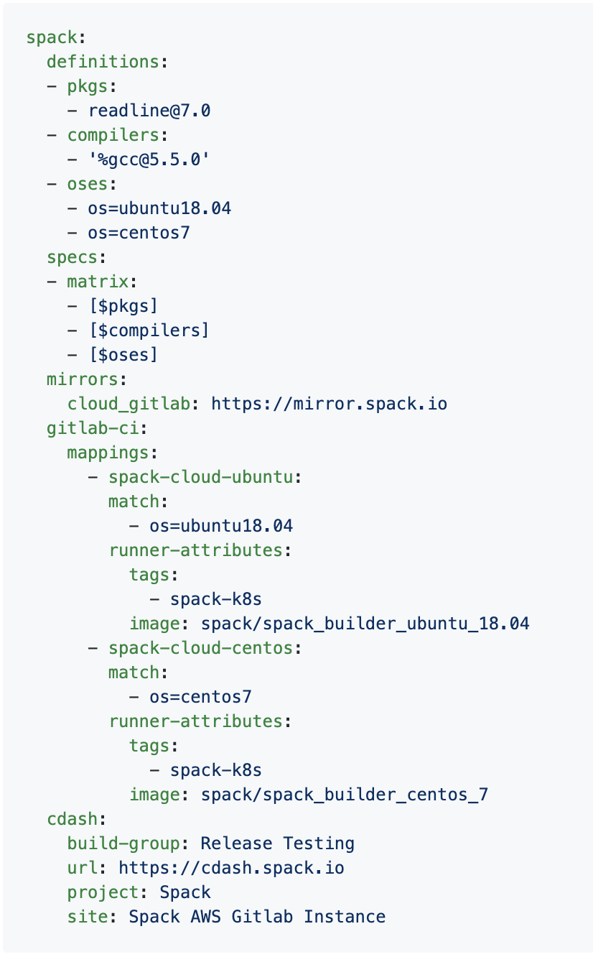

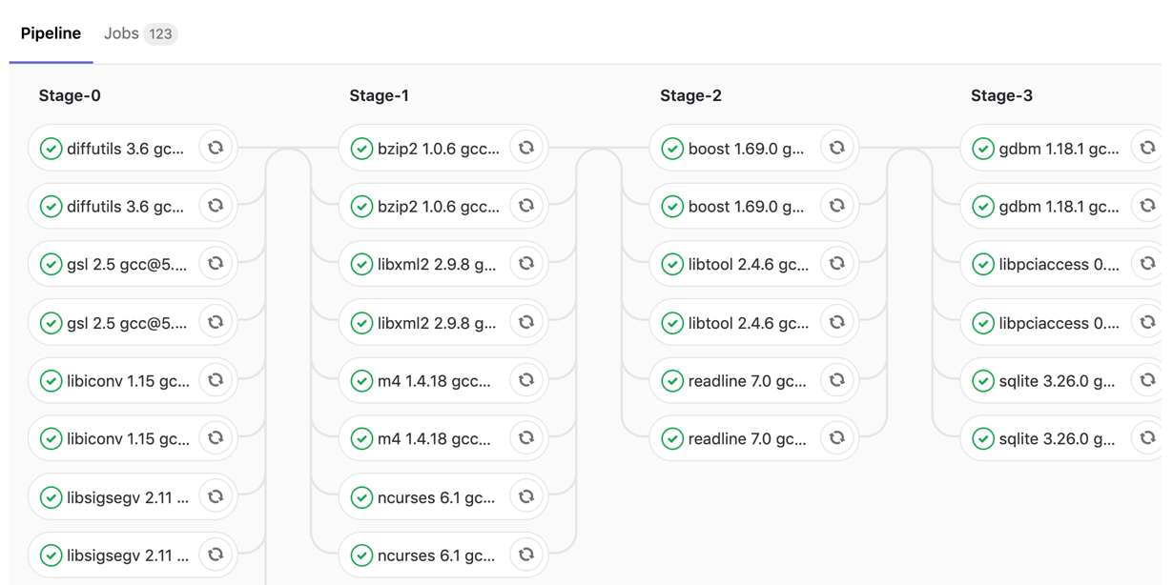
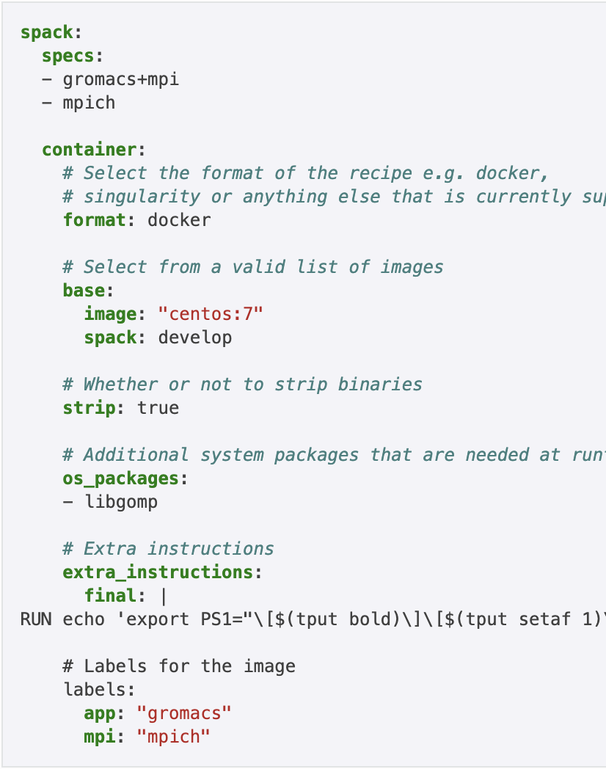
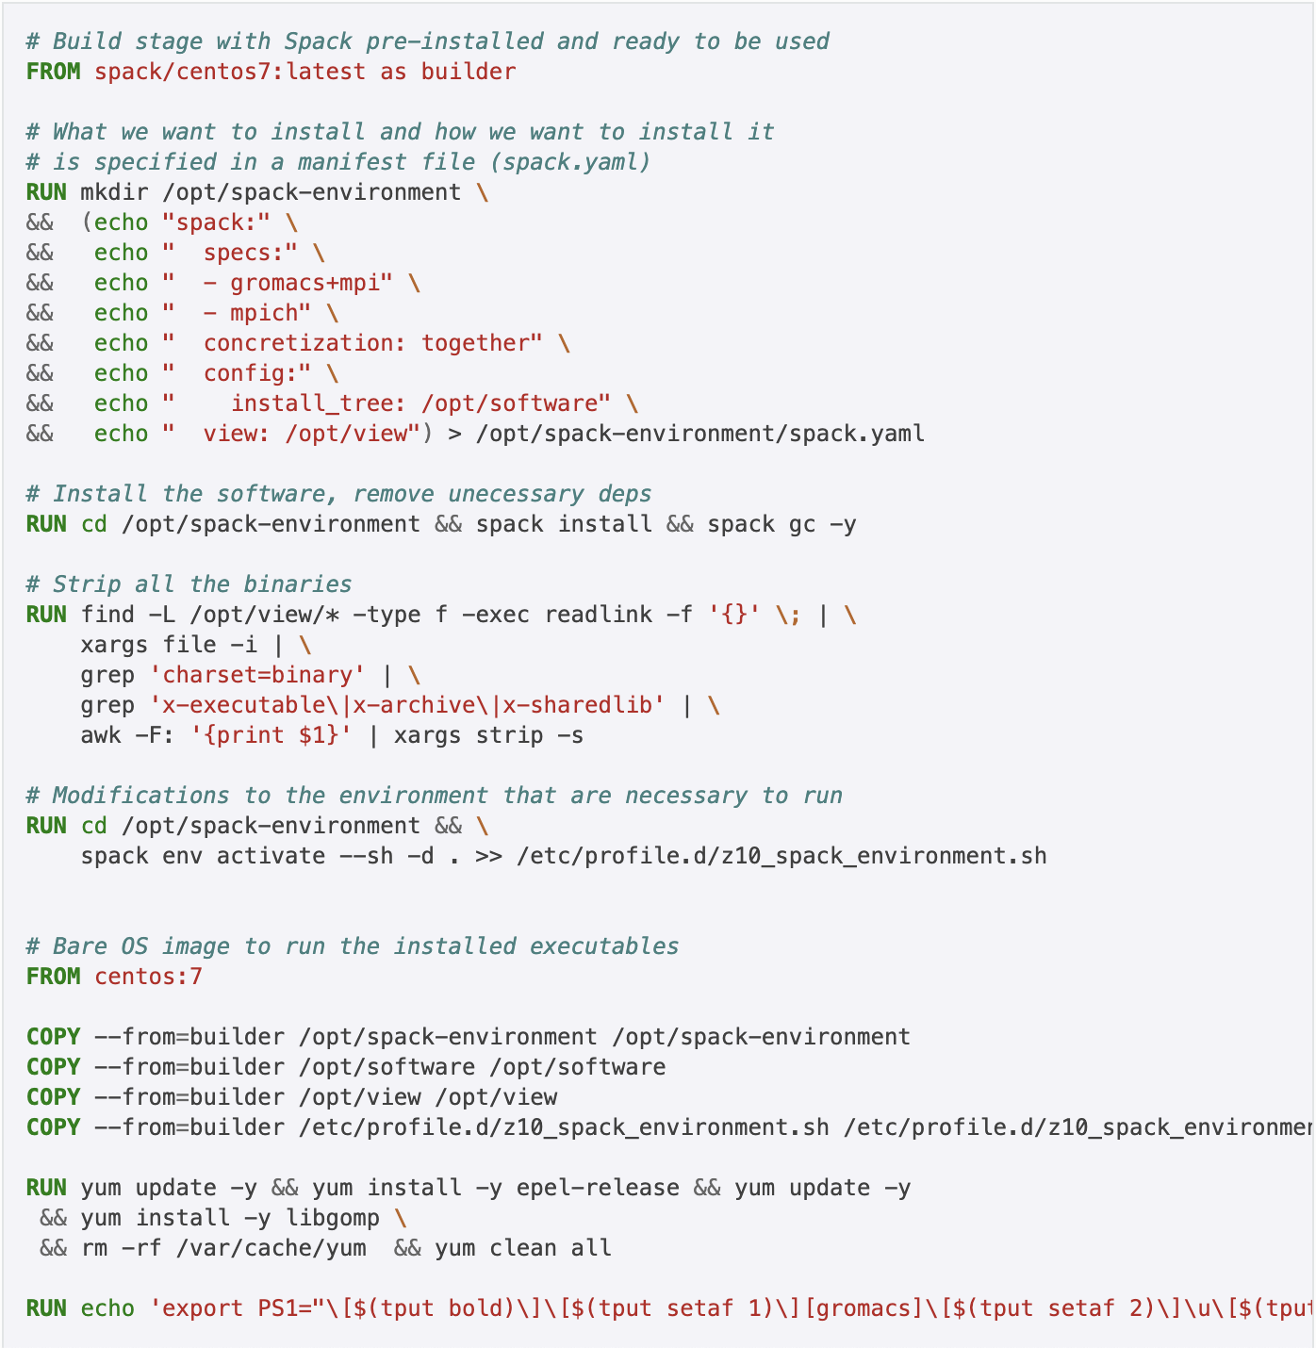

Environments have enabled us to add build many features to support developer workflows
spack external find
Automatically find and configure external packages on the system
class Libsigsegv(AutotoolsPackage, GNUMirrorPackage):
"""GNU libsigsegv is a library for handling page faults in user mode."""
# ... spack package contents ...
extra_install_tests = ‘tests/.libs’
def test(self):
data_dir = self.test_suite.current_test_data_dir
smoke_test_c = data_dir.join(‘smoke_test.c’)
self.run_test(
'cc’, [
'-I%s' % self.prefix.include,
'-L%s' % self.prefix.lib, '-lsigsegv’,
smoke_test_c,
'-o', 'smoke_test'
]
purpose='check linking’)
self.run_test(
‘smoke_test’, [], data_dir.join('smoke_test.out’),
purpose=‘run built smoke test’)
self.run_test('sigsegv1': ['Test passed’], purpose='check sigsegv1 output’)
self.run_test('sigsegv2': ['Test passed’], purpose='check sigsegv2 output’)
spack test
package.py
spack.yaml configuration
Packages know how to run their own test suites
package.py
spack ci
Automatically generate parallel build pipelines
(more on this later)
.gitlab-ci.yml CI pipeline
spack containerize
spack.yaml
Turn environments into container build recipes

Slide 33
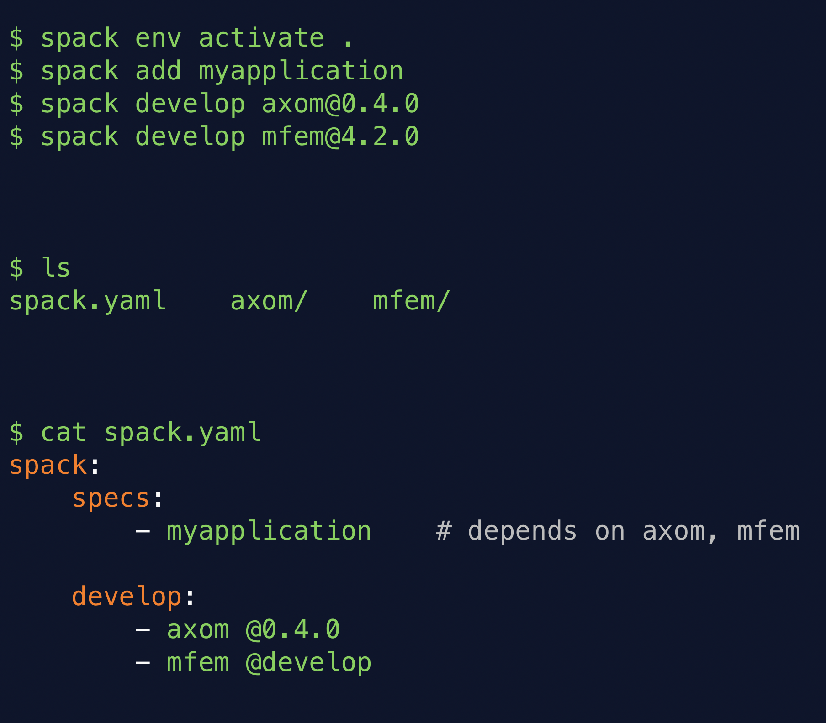
spack develop lets developers work on many packages at once
Developer features so far have focused on single packages (spack dev-build, etc.)
New spack develop feature enables development environments
Work on a code
Develop multiple packages from its dependencies
Easily rebuild with changes
Builds on spack environments
Required changes to the installation model for dev packages
dev packages don’t change paths with configuration changes
Allows devs to iterate on builds quickly

Slide 34
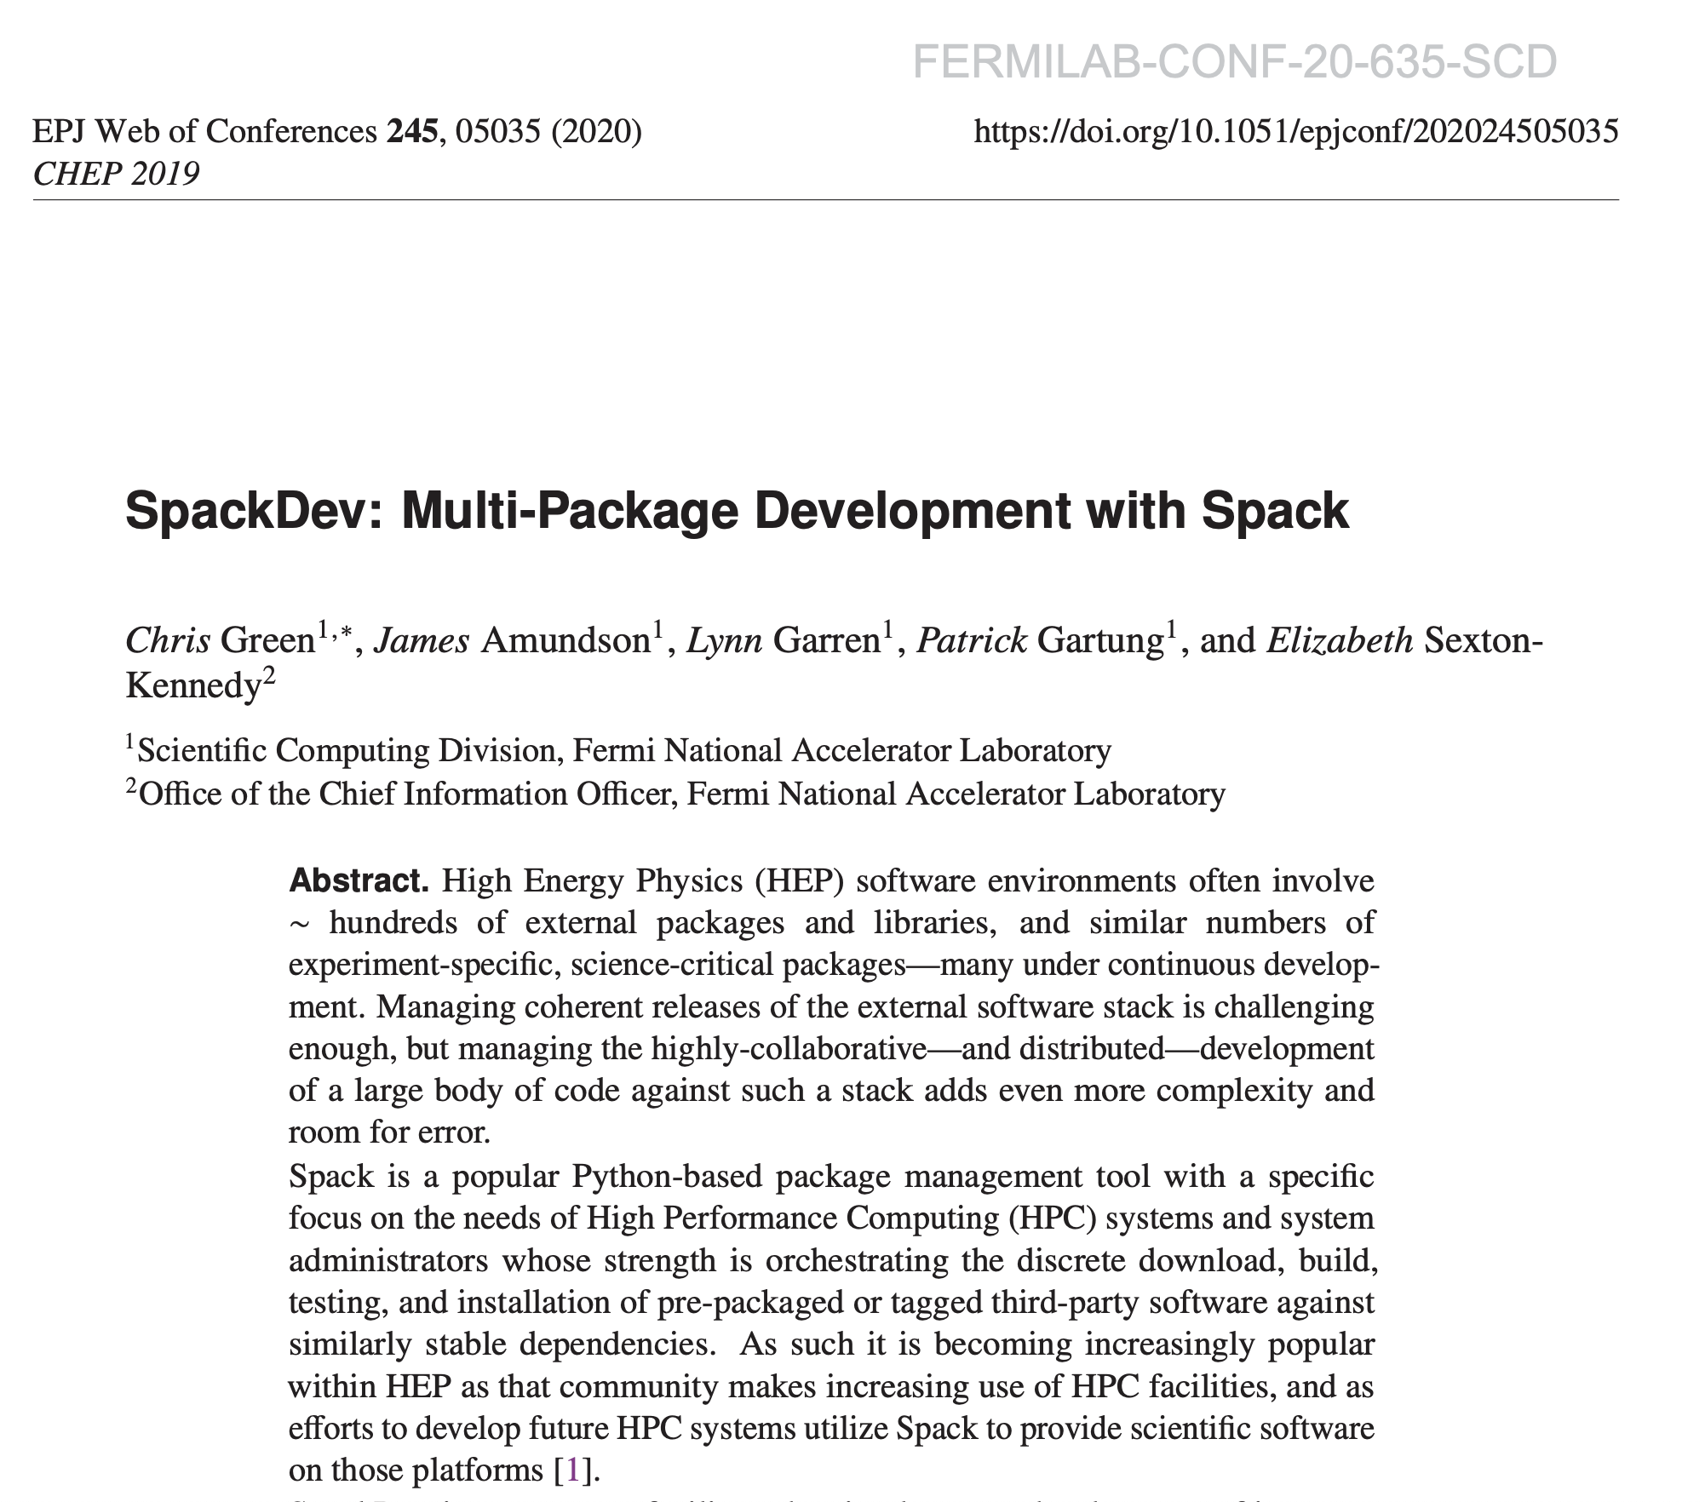
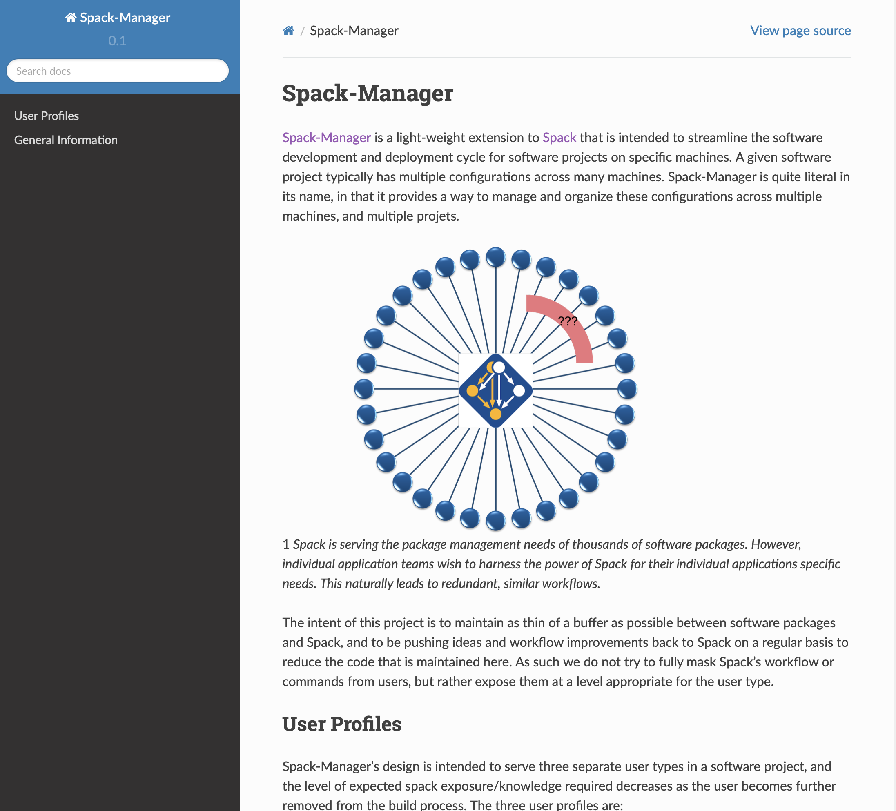
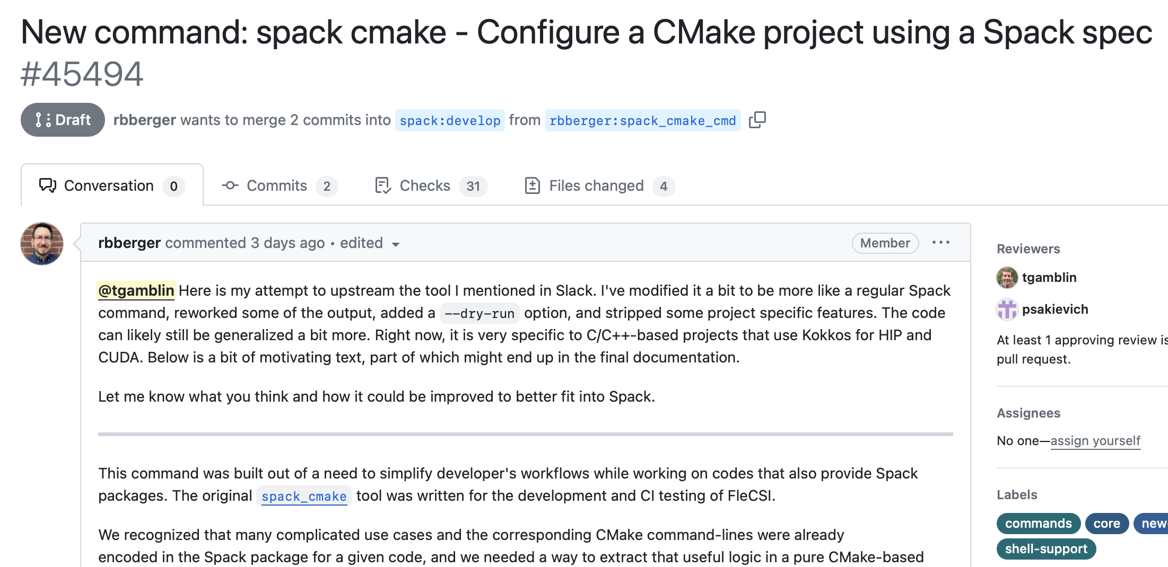
Teams are building development front-ends top of on Spack
Many different approaches:
Thin mack wrapper for MARBL team at LLNL
spack-manager at Sandia
SpackDev at Fermilab
spack-organizer at CEA
spack_cmake at LANL
Workflow seems to be converging around environments + spack develop
We are trying to bring many of the features from these scripts into core
Most of the front-ends are opinionated in one way or another
We want spack to support but not force these workflows

Slide 35
Solving and Complexity

Slide 36
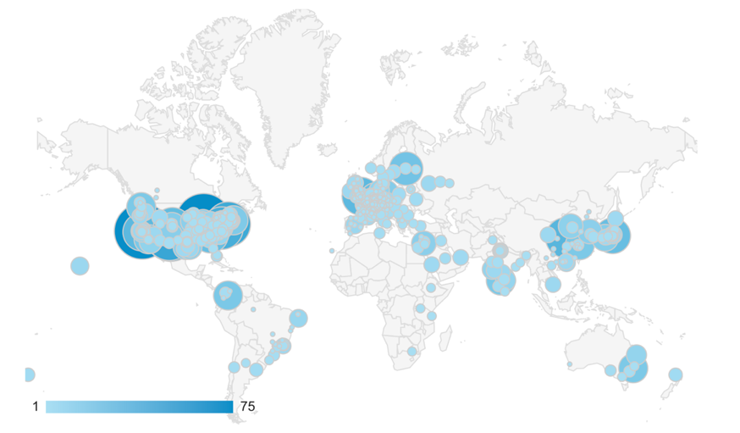
The concretizer includes information from packages, configuration, and CLI
Dependency solving is NP-hard
Contributors
package.py repository
new versions
new dependencies
new constraints
concretizer
spack developers
default config
packages.yaml
yaml
admins, users
local preferences config packages.yaml
yaml
users
local environment config spack.yaml
yaml
Concrete spec is fully constrained
and can be built.
Command line constraints
users
spack install hdf5@1.12.0 +debug

Slide 37
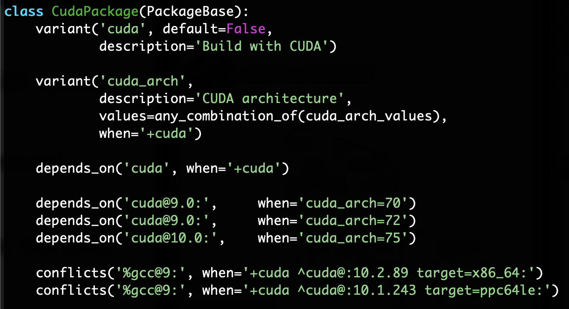
Spack packages use a lot of (declarative) conditional logic
CudaPackage: a mix-in for packages that use CUDA
cuda is a variant (build option)
cuda_arch is only present if cuda is enabled
dependency on cuda, but only if cuda is enabled
constraints on cuda version
compiler support for x86_64 and ppc64le
There is a lot of expressive power in the Spack package DSL.

Slide 38
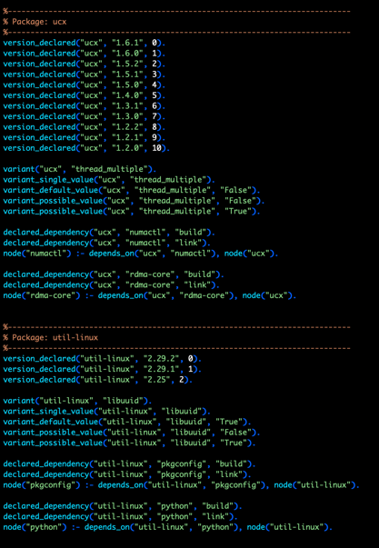
We reimplemented Spack’s concretizer using Answer Set Programming
Was originally a greedy, custom Python algorithm
Answer Set Programming is a declarative programming paradigm
Looks like Prolog
Built around modern CDCL SAT solver techniques
Designed for combinatorial search problems
ASP program has 2 parts:
Large list of facts generated from package recipes (problem instance)
60k+ facts is typical – includes dependencies, options, etc.
Small logic program (~700 lines of ASP code)
Algorithm (the part we write) is conceptually simpler:
Generate facts for all possible dependencies
Send facts and our logic program to the solver
Rebuild a DAG from the results
We’re using Clingo, the Potassco grounder/solver package
Some facts for HDF5 package

Slide 39
Spack’s concretizer is implemented using Answer Set Programming (ASP)
ASP looks like Prolog but is converted to SAT with optimization
Facts describe the graph
lammps
node("lammps").
node("cuda").
variant_value("lammps", "cuda", "True").
depends_on("lammps", "cuda").
+cuda
cuda
First-order rules (with variables) describe how to resolve nodes and metadata
node(Dependency) :- node(Package), depends_on(Package, Dependency).
node("hdf5"). depends_on("hdf5", "mpi").
Ground Rule
node("mpi")

Slide 40
Grounding converts a first-order logic program into a propositional logic program, which can be solved.
a
b
c
b
d
d
a
b
c
d
Answer 1: Only node(b) is true Answer 2: Both node(a) and node(b) are true
We use the Clingo solver from potassco.org

Slide 41
ASP searches for stable models of the input program
Stable models are also called answer sets
A stable model (loosely) is a set of true atoms that can be deduced from the inputs, where every rule is idempotent.
Similar to fixpoints
Put more simply: a set of atoms where all your rules are true!
Unlike Prolog:
Stable models contain everything that can be derived (vs. just querying values)
Good ways to do optimization to select the “best” stable model
ASP is guaranteed to complete!

Slide 42
Originally, Spack only reuse builds if hashes matched
This is now: spack install --fresh
Hash matches are very sensitive to small changes
In many cases, a satisfying cached or already installed spec can be missed
Nix, Spack, Guix, Conan, and others reuse this way
1. Resolve metadata
2. Create per-node hashes
cwx4qwk4bkamf4gjrglmxfu3bhasyt74
qo2af23r2npatxdtna3fmwkeennywixp
k2yumgxwq6ijubivfpbjpmrrbzyqcoot
Package cache
4xxvh5ldm7gm32ngtixcm2odaer3cvvb
74mwnxgn6nujehpyyalhwizwojwn5zga
??
6zvh4ueem6f5yrcfugh67k2hrtxbgbcs
3. Query for exact hash match

Slide 43
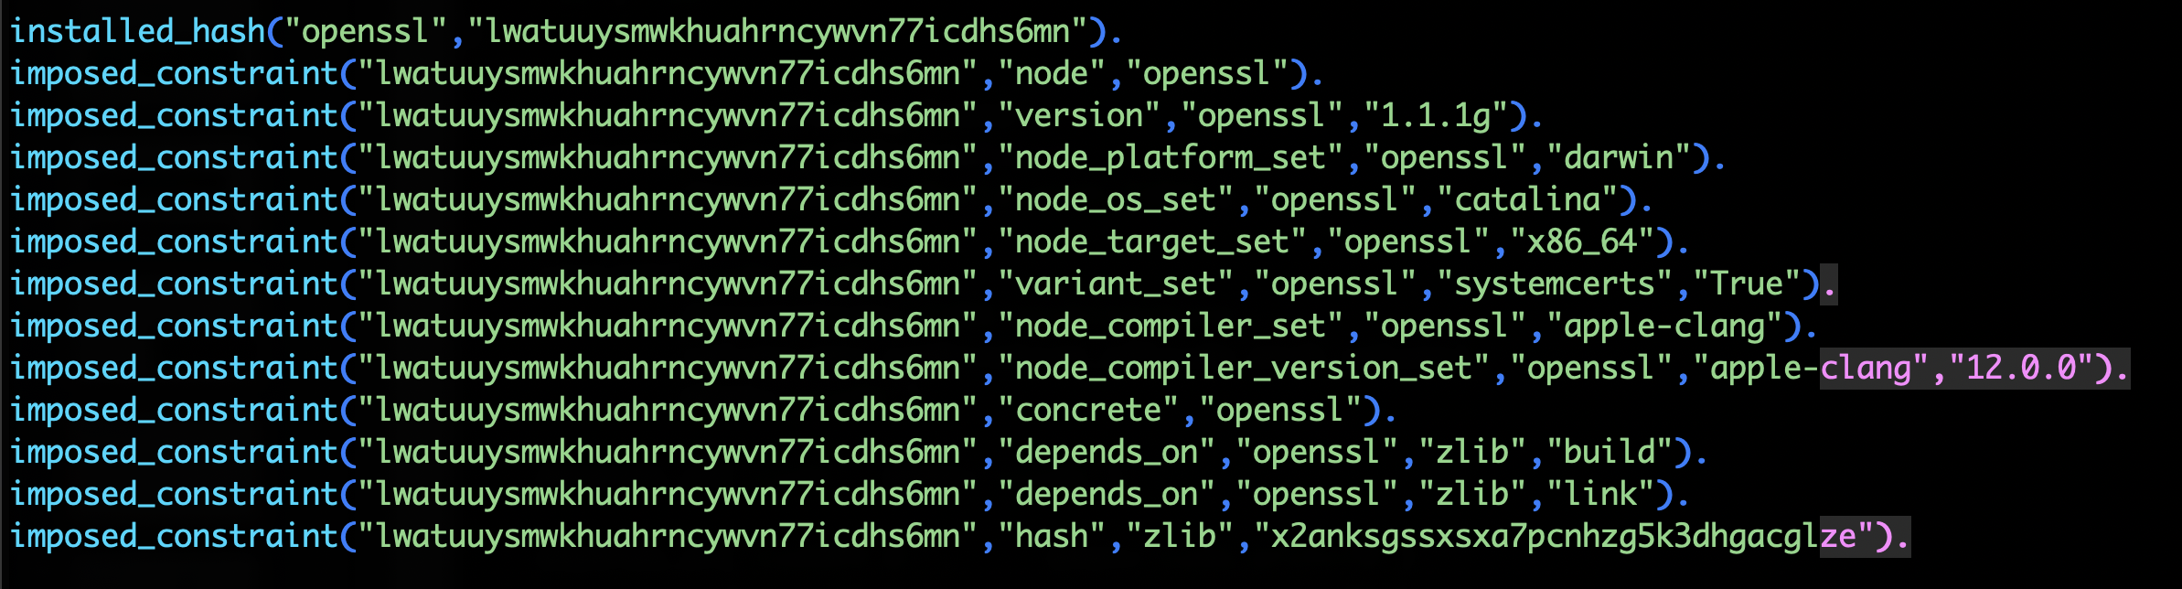
--reuse (now the default) was enabled by ASP
--reuse tells the solver about all the installed packages!
Add constraints for all installed packages, with their hash as the associated ID:

Slide 44
Telling the solver to minimize builds is surprisingly simple in ASP
1. Allow the solver to choose a hash for any package:
2. Choosing a hash means we impose its constraints:
3. Define a build as something without a hash:
4. Minimize builds!

Slide 45
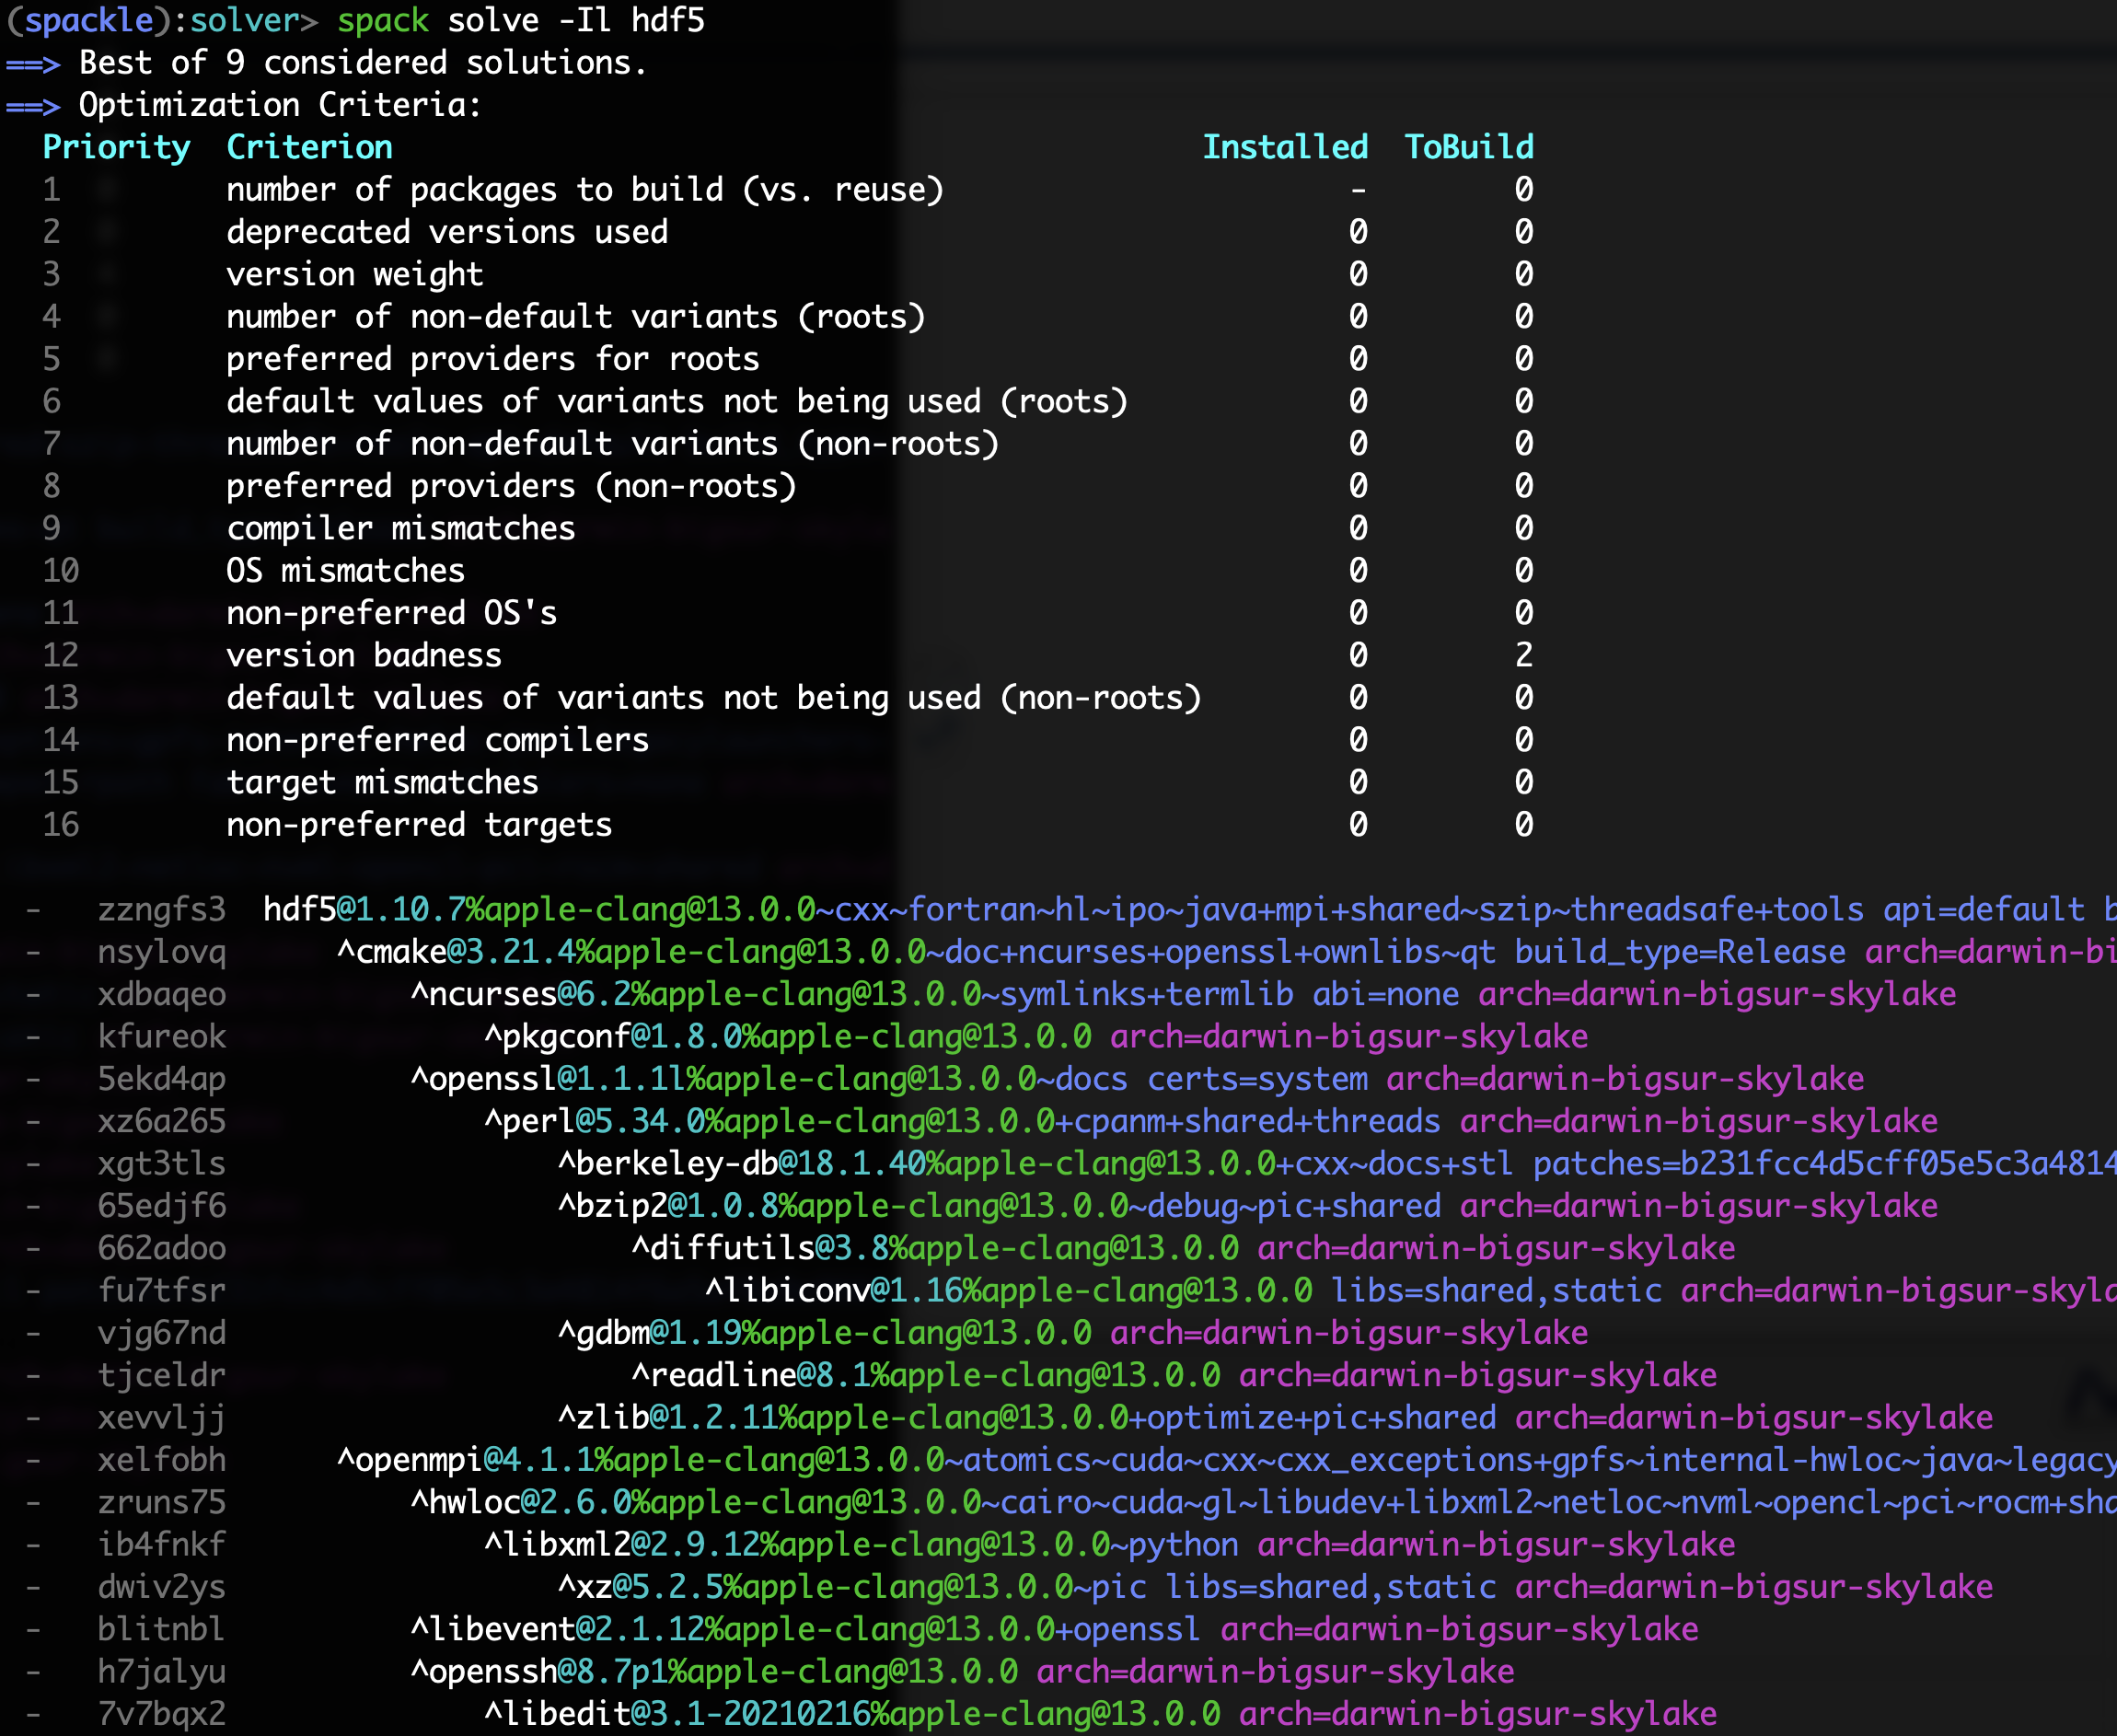
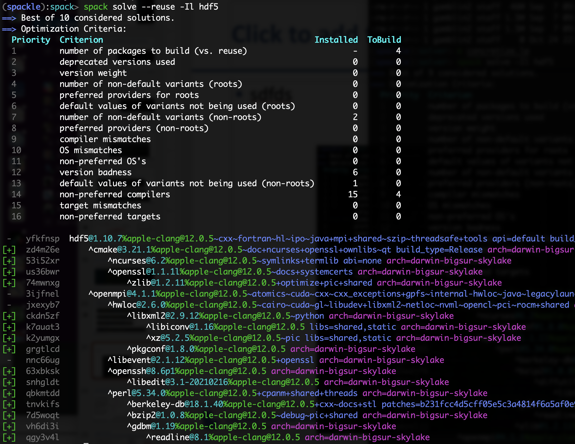

With and without --reuse optimization
Pure hash-based reuse: all misses
With reuse: 16 packages were reusable

Slide 46
Recent Challenges

Slide 47
Some stats on problem sizes
Main logic program is:
~250 rules
20 optimization criteria
933 lines of ASP code
Problem instances can vary quite a bit
Common dependencies get us some magic numbers
gmake’s optional dependency on guile makes most solves consider at least 527 packages
gnuconfig is notably very simple ☺
Package | Possible dependencies | Facts
gnuconfig | 1 | 150
zlib | 527 | 30,095
gmake | 527 | 30,160
openmpi | 527 | 109,021
qt | 527 | 109,029
trilinos | 694 | 224,142
root | 699 | 146,372
mfem | 714 | 273,078
r-condop | 774 | 142,212
warpx | 819 | 319,374
exawind | 820 | 322,535

Slide 48
We have been working to make our solver more flexible
gptune
Only one configuration per package allowed in the DAG
Ensures ABI compatibility but is too restrictive
In the example py-numpy needs to use py-cython@0.29 as a build tool
That enforces using an old py-gevent, because newer versions depend on py-cython@3.0 or greater
py-gevent@1.5
py-numpy
py-cython@0.29

Slide 49
Objective: dependency splitting
The constraint on build dependencies can be relaxed, without compromising the ABI compatibility
Having a single configuration of a package is now enforced on unification sets
These are the set of nodes used together at runtime (the one shown is for gptune)
This allows us to use the latest version of py-gevent, because now we can have two versions of py-cython
gptune
Unification Set
py-gevent@23.7
py-numpy
py-cython@3.0
py-cython@0.29

Slide 50
We want to dynamically “split” nodes when needed
Start with deducing single dependency nodes:
node(DependencyName) :- dependency_holds(PkgName, DependencyName)
Converted node identifier from name to (name, id)
Want to allow solver to choose to duplicate a node:
1 {
depends_on(PkgNode, node(0..Y-1, DepNode), Type) : max_dupes(DepNode, Y)
} 1 :- dependency_holds(PkgNode, DepNode).

Slide 51
Generic package metadata can be used with any duplicate node
pkg_fact("alsa-lib",version_declared("1.2.3.2",0,"package_py")).
pkg_fact("alsa-lib",version_declared("1.2.2",1,"package_py")).
pkg_fact("alsa-lib",version_declared("1.1.4.1",2,"package_py")).
pkg_fact("alsa-lib",condition(20)).
condition_reason(20,"alsa-lib depends on python when +python").
pkg_fact("alsa-lib",condition_trigger(20,15)).
Facts that come from package descriptions can be used with all duplicate nodes
We now have to ground multiple copies of most of our rules
Performance still scales with total number of possible nodes
Small numbers of duplicates don’t really explode the solve

Slide 52
First try at allowing duplicates in a single solve
Increased solve times by >> 2x in some cases

Slide 53
It turns out that cycle detection in the solver is expensive
path(A, B) :- depends_on(A, B).
path(A, C) :- path(A, B), depends_on(B, C).
% this constraint says "no cycles"
:- path(A, B), path(B, A).
Has to maintain path() predicate representing paths between nodes
Cycles are actually rare in solutions
Switched to post-processing for cycle detection
Only do expensive solve if a cycle is detected in a solution
Similar issue arose for variant propagation in graph
Fixed by reworking variant propagation not to track paths
50%+ improvement in solve time

Slide 54
Unification sets can be expensive too
gptune
Unification set creation was originally recursive for any build dependencies
Ends up blowing up grounding
Mitigation:
Only create new sets for explicitly marked build tools
Transitive build dependencies that are not from marked build tools go into a common unification set
Need better heuristics to split when necessary for full generality
py-gevent@23.7
py-numpy
py-cython@3.0
py-cython@0.29

Slide 55
Optimizations: Solve Time
Optimizations: Solve Time

Slide 56
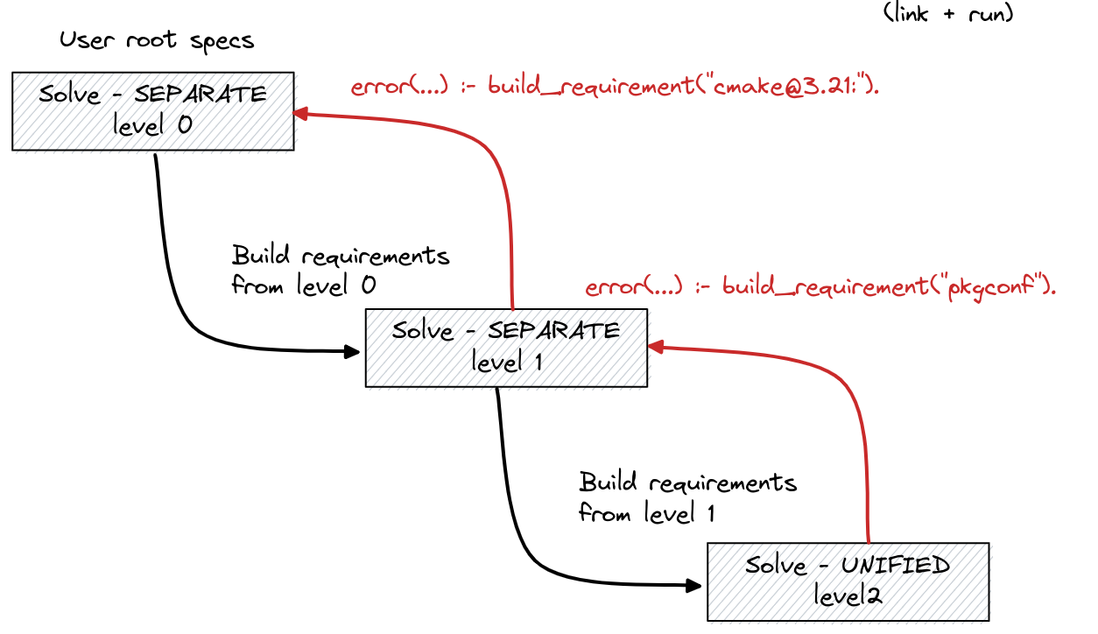
It was not trivial to come up with this model
In addition to this “coupled” method, we tried an iterative version with multiple solves
Multiple solves had some disadvantages:
Slower due to overhead of multiple solves
Not coupled, so feedback from solve to solve was awkward
Packagers needed to “help” the solver
Requiring packagers to provide solve hints in packages isn’t practical

Slide 57
Recent Work

Slide 58
Spack v0.22.0 is out!
Highlights:
Compiler runtime dependencies
gcc-runtime, intel-oneapi-runtime, libgfortran, libc
OS compatibility on linux now uses libc version, not OS tag
Improved spack find UI for Environments
Improved command-line string quoting
Revert default spack install behavior to --reuse
More control over reused specs
New redistribute() directive
New conflict: and prefer: syntax for package preferences
include_concrete: in environments
python-venv isolation
github.com/spack/spack
Full release notes: https://github.com/spack/spack/releases/tag/v0.22.0

Slide 59
We’ve made a lot of progress on compiler dependencies
Compiler runtime libraries represented in the graph
C++, Fortran runtimes
libc is now represented in dependency graphs on Linux
No more need to rely on OS tag for compatibility information
Reuse binaries without their compiler needing to be configured locally
Improved buildcache hit rate using libraries for compatibility

Slide 60
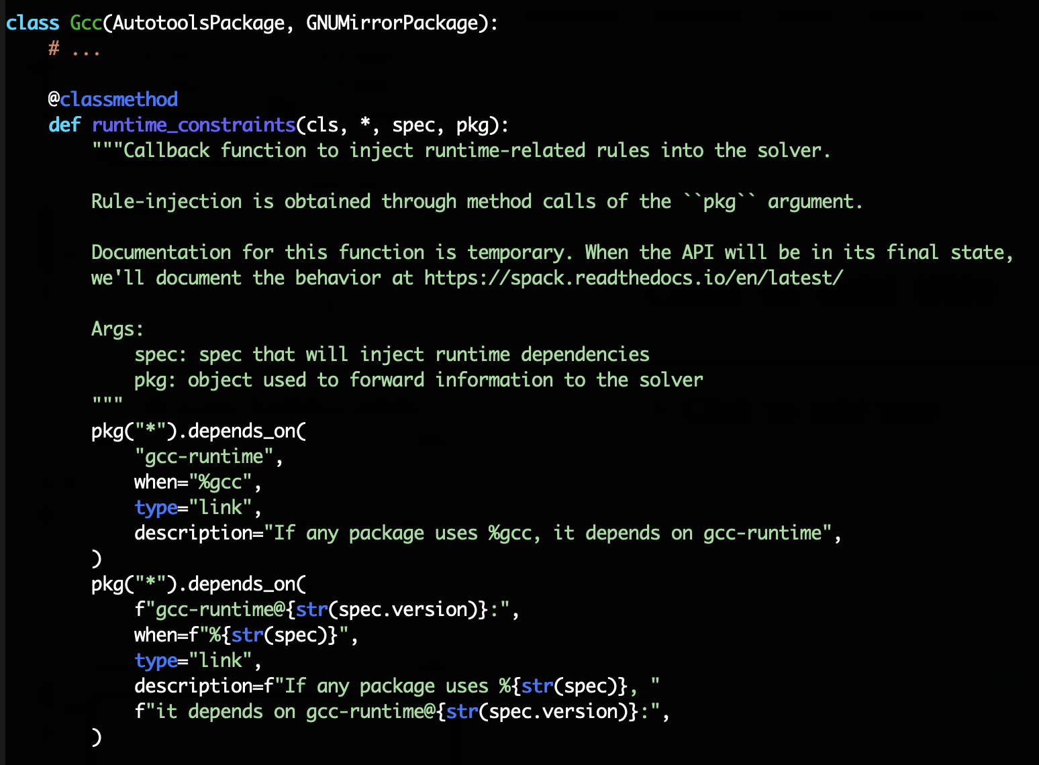
Compilers can now model their own runtimes
New method, runtime_constraints, for injecting runtimes into graphs
Currently supported for gcc, intel-oneapi
still working on others
Allows solver to take libstdc++, fortran rutime compatibility into account.
Example:
Intel compilers now (correctly) depend on gcc-runtime

Slide 61
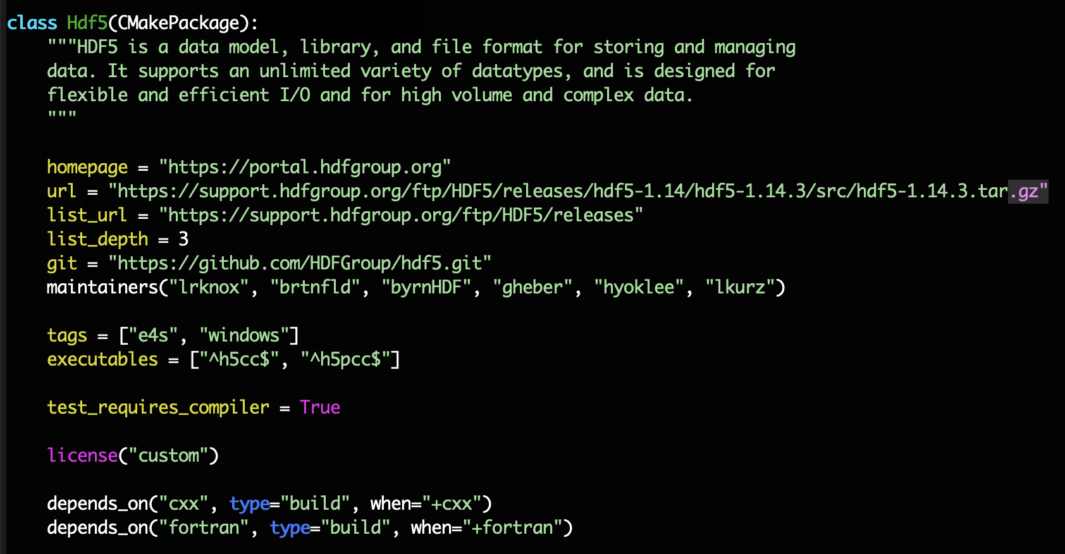
Packages now declare the languages they depend on
Languages are almost virtuals
HDF5 package depends on cxx and fortran
Handled specially internally, until compilers are nodes
Imply a compiler and compiler package can specify runtime libraries to inject
Allows solver to mix compilers correctly
Runtimes are unified like other nodes
Package authors can model toolchain properties
probably not for most package authors, but very powerful
TBD:
Other runtimes like clang libraries and OpenMP
Compilers as nodes in the graph

Slide 62
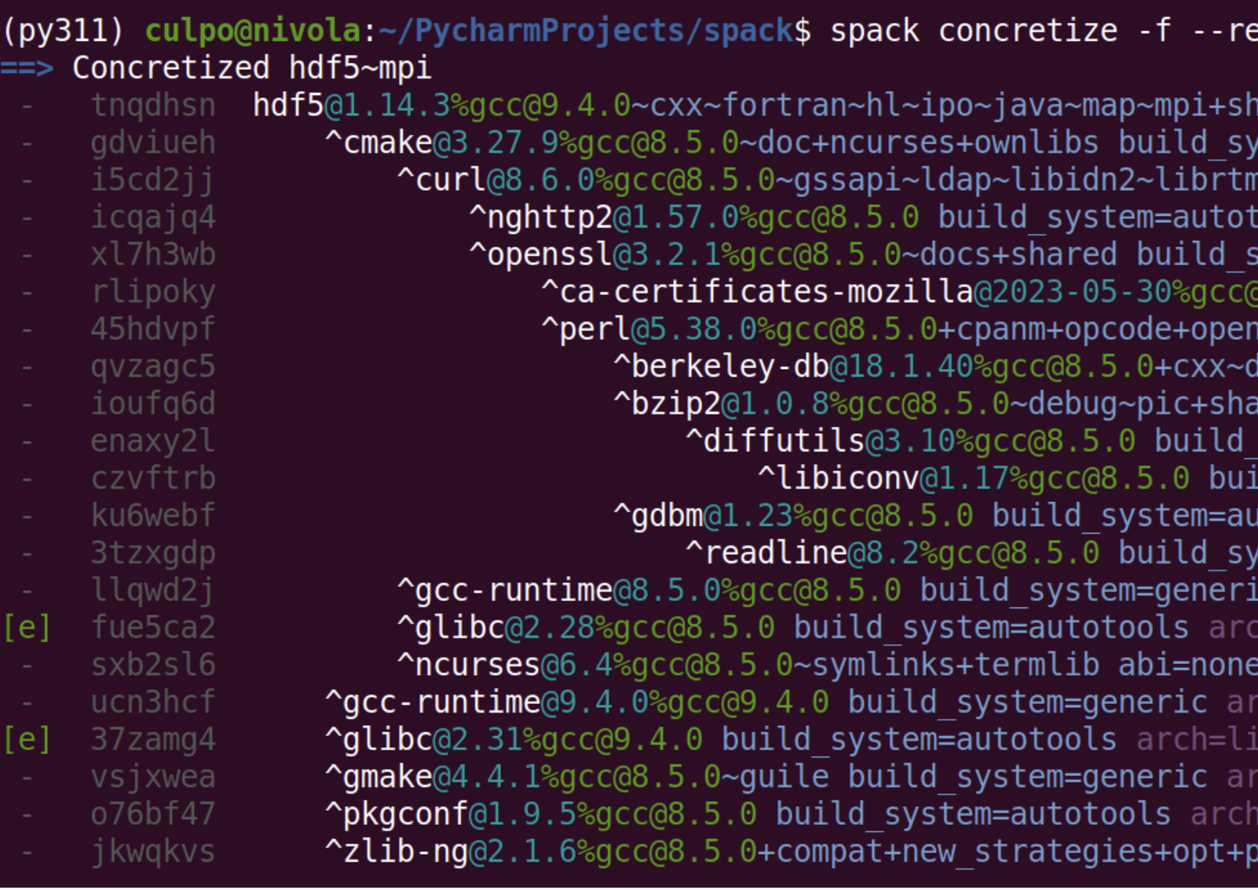
We’ve also added libc as a dependency
libc is a virtual
glibc and musl packages are providers
(nearly) every graph has libc in it, via the compiler
Can be external or built by Spack
We are not building libc for every stack in Spack
Automatically detect system libc version
Add a node to the graph to be used for binary compatibility
No longer using OS tags for buildcaches
Now use libc for this
many more buildcache hits

Slide 63
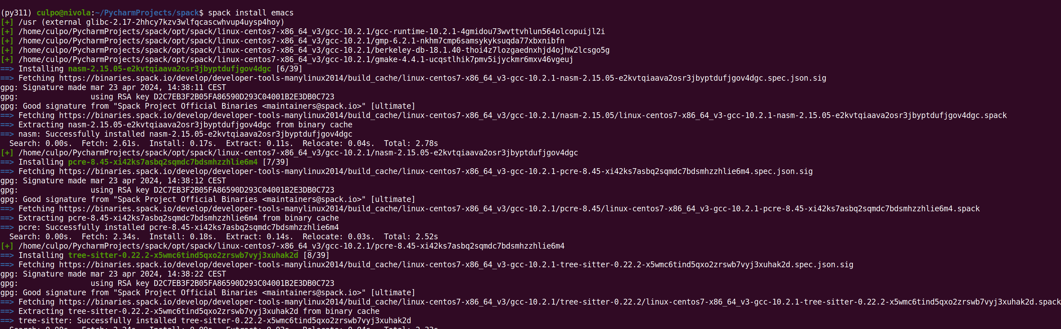
Libc modeling makes for a much better buildcache experience
Currently on develop (emacs 100% from binary):

Slide 64
Roadmap

Slide 65
Roadmap for this year
Finish compiler dependencies
Compilers will appear as build dependencies
All special compiler logic generified for any build dependency
Enable bootstrapping compilers from buildcache
Continue to flesh out low-level compiler runtime libraries
Harden public build caches and make them more broadly compatible
Enable bare-metal MPI/CUDA/ROCm installations
Make the build cache on by default; build only what we need from source
Automatic Python package generation
Continue to improve Windows support
Speed improvements for concretization and metadata management
Lots of exciting work ahead!

Slide 66
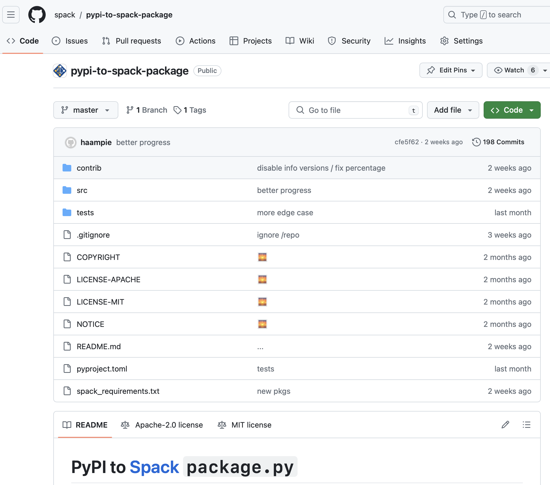
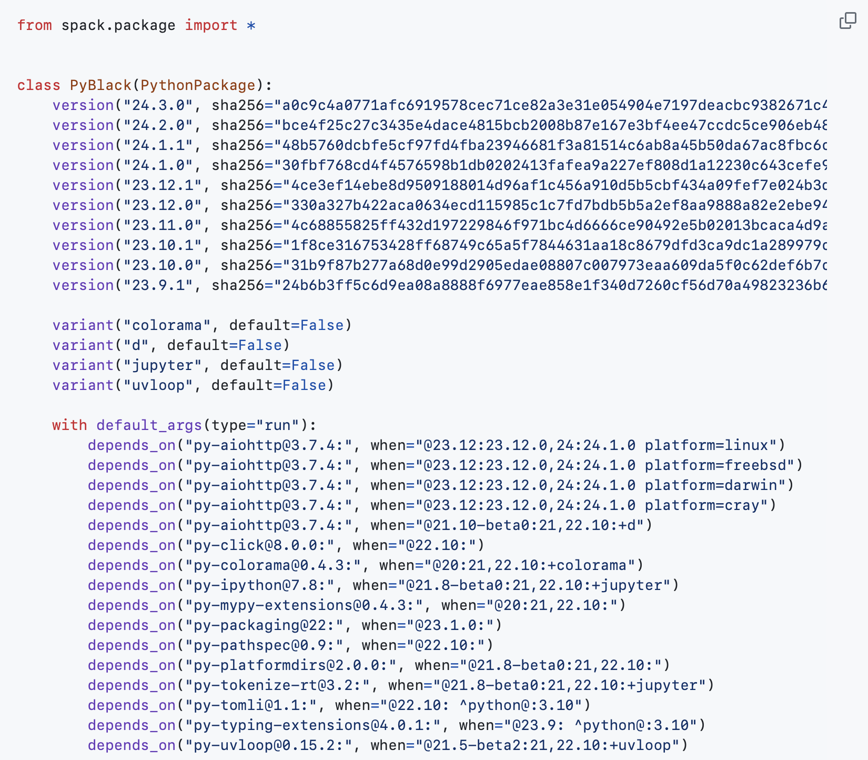
Autogenerating Python packages
Python ecosystem is a lot to maintain
Increasingly, we need to update faster than we can sustain through pull requests
Reviewing version ranges has been painful
We added features to our version system to support Python better
Prerelease, alpha, beta version comparison
We can now generate Python packages from PyPI metadata
Only for pure python packages
Native packages will be maintained as regular Spack packages
Overlay on top of auto-generated python packages

Slide 67
Generating Python
Had to rework version system to handle some frequent python conventions
Prereleases
Alpha, beta
Release candidate
Now PyPI metadata can map to Spack depends_on() constraints
Some caveats
Only doing this for pure python packages
Wheels (and PyPI database) lack build dependency info
May not be able to use spack develop with these

Slide 68
When would we go to “Version 1.0”?
Big things we’ve wanted for 1.0 are:
New concretizer
production CI
production public build cache
Compilers as dependencies
Buildcache hardening
Stable package API
Enables separate package repository
We are getting very close!
Done!
Aiming for November
Aiming for June

Slide 69



Join the Spack community!
Join us and 3,200 others on slack.spack.io
Contribute packages, documentation, and features on GitHub
Continue the tutorial at spack-tutorial.rtfd.io
Star us on GitHub!
slack.spack.io
@spackpm
github.com/spack/spack
We hope to make distributing & using HPC software easy!

Slide 70
Disclaimer
This document was prepared as an account of work sponsored by an agency of the United States government. Neither the United States government nor Lawrence Livermore National Security, LLC, nor any of their employees makes any warranty, expressed or implied, or assumes any legal liability or responsibility for the accuracy, completeness, or usefulness of any information, apparatus, product, or process disclosed, or represents that its use would not infringe privately owned rights. Reference herein to any specific commercial product, process, or service by trade name, trademark, manufacturer, or otherwise does not necessarily constitute or imply its endorsement, recommendation, or favoring by the United States government or Lawrence Livermore National Security, LLC. The views and opinions of authors expressed herein do not necessarily state or reflect those of the United States government or Lawrence Livermore National Security, LLC, and shall not be used for advertising or product endorsement purposes.

Slide 71
An isolated compilation environment allows Spack to easily swap compilers
Spack Process
Forked build process isolates environment for each build. Uses compiler wrappers to:
Add include, lib, and RPATH flags
Ensure that dependencies are found automatically
Load Cray modules (use right compiler/system deps)
do_install()
Install dep1
Install dep2
…
Install package
icc
icpc
ifort
Fork
Build Process
Set up environment
CC = spack/env/spack-cc SPACK_CC = /opt/ic-15.1/bin/icc
CXX = spack/env/spack-c++ SPACK_CXX = /opt/ic-15.1/bin/icpc
F77 = spack/env/spack-f77 SPACK_F77 = /opt/ic-15.1/bin/ifort
FC = spack/env/spack-f90 SPACK_FC = /opt/ic-15.1/bin/ifort
PKG_CONFIG_PATH = ... PATH = spack/env:$PATH
CMAKE_PREFIX_PATH = ...
LIBRARY_PATH = ...
Compiler wrappers (spack-cc, spack-c++, spack-f77, spack-f90)
-I /dep1-prefix/include
-L /dep1-prefix/lib
-Wl,-rpath=/dep1-prefix/lib
install()
configure
make
make install

Slide 72
OCI build caches
Spack can now use arbitrary OCI registries as buildcaches
And you can optionally add a base image to get runnable images
$ spack mirror add my_registry oci://user/image # Dockerhub
$ spack mirror add my_registry oci://ghcr.io/haampie/spack-test # GHCR
$ spack mirror set --push --oci-username ... --oci-password ... my_registry # set login
$ spack buildcache push my_registry [specs...]$ spack solve hdf5 ^cmake@3.0.1
$ spack buildcache push --base-image ubuntu:23.04 my_registry python
Pushed ... as [image]:python-3.11.2-65txfcpqbmpawclvtasuog4yzmxwaoia.spack
$ docker run --rm -it [image]:python-3.11.2-65txfcpqbmpawclvtasuog4yzmxwaoia.spack

Slide 73
ASP has enabled us to improve Spack’s error messages
$ spack solve hdf5 ^cmake@3.0.1
==> Error: concretization failed for the following reasons:
1. Cannot satisfy 'cmake@3.0.1’ 2. Cannot satisfy 'cmake@3.0.1’ required because hdf5 ^cmake@3.0.1 requested from CLI 3. Cannot satisfy 'cmake@3.18:' and 'cmake@3.0.1 required because hdf5 ^cmake@3.0.1 requested from CLI required because hdf5 depends on cmake@3.18: when @1.13: required because hdf5 ^cmake@3.0.1 requested from CLI 4. Cannot satisfy 'cmake@3.12:' and 'cmake@3.0.1 required because hdf5 depends on cmake@3.12: required because hdf5 ^cmake@3.0.1 requested from CLI required because hdf5 ^cmake@3.0.1 requested from CLI

Slide 74
Spack’s solver uses “generalized” conditions in ASP
ASP rules: when the right side is true, the left is true
Generalized conditions:
When condition requirements are True, the condition holds
When the condition holds, the imposed constraints are attributes of the spec
This is how all conditional logic in Spack is implemented
variant_value(Pkg, Variant, Value) :- variant_set(Pkg, Variant, Value), node(Pkg).
condition_holds(ID).
:- attr(Name, A1), : condition_requirement(Name, A1);
attr(Name, A1 , A2), : condition_requirement(Name, A1, A1).
attr(Name, A1) :- condition_holds(ID), imposed_constraint(ID, Name, A1).
attr(Name, A1, A2) :- condition_holds(ID), imposed_constraint(ID, Name, A1, A2).

Slide 75
We now build chains of causes and effects from the error message back to other sources of the problem
condition_cause(Effect, Cause) :-
condition_holds(Effect),
condition_holds(Cause),
attr(Name, A1),
condition_requirement(Effect, Name, A1),
imposed_constraint(Cause, Name, A1, A2).
Arity 1
condition_cause(Effect, Cause) :-
condition_holds(Effect),
condition_holds(Cause),
attr(Name, A1, A2),
condition_requirement(Effect, Name, A1, A2),
imposed_constraint(Cause, Name, A1, A2).
Arity 2
etc.

